Slide 1

Networks and Gastronomy
G. Caldarelli

Slide 2
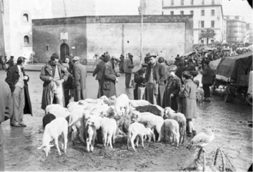
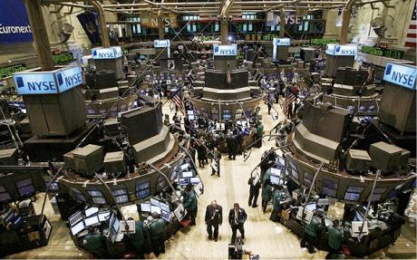

Complexity and Food
Complex Systems are those systems where a new behaviour emerge

Slide 3
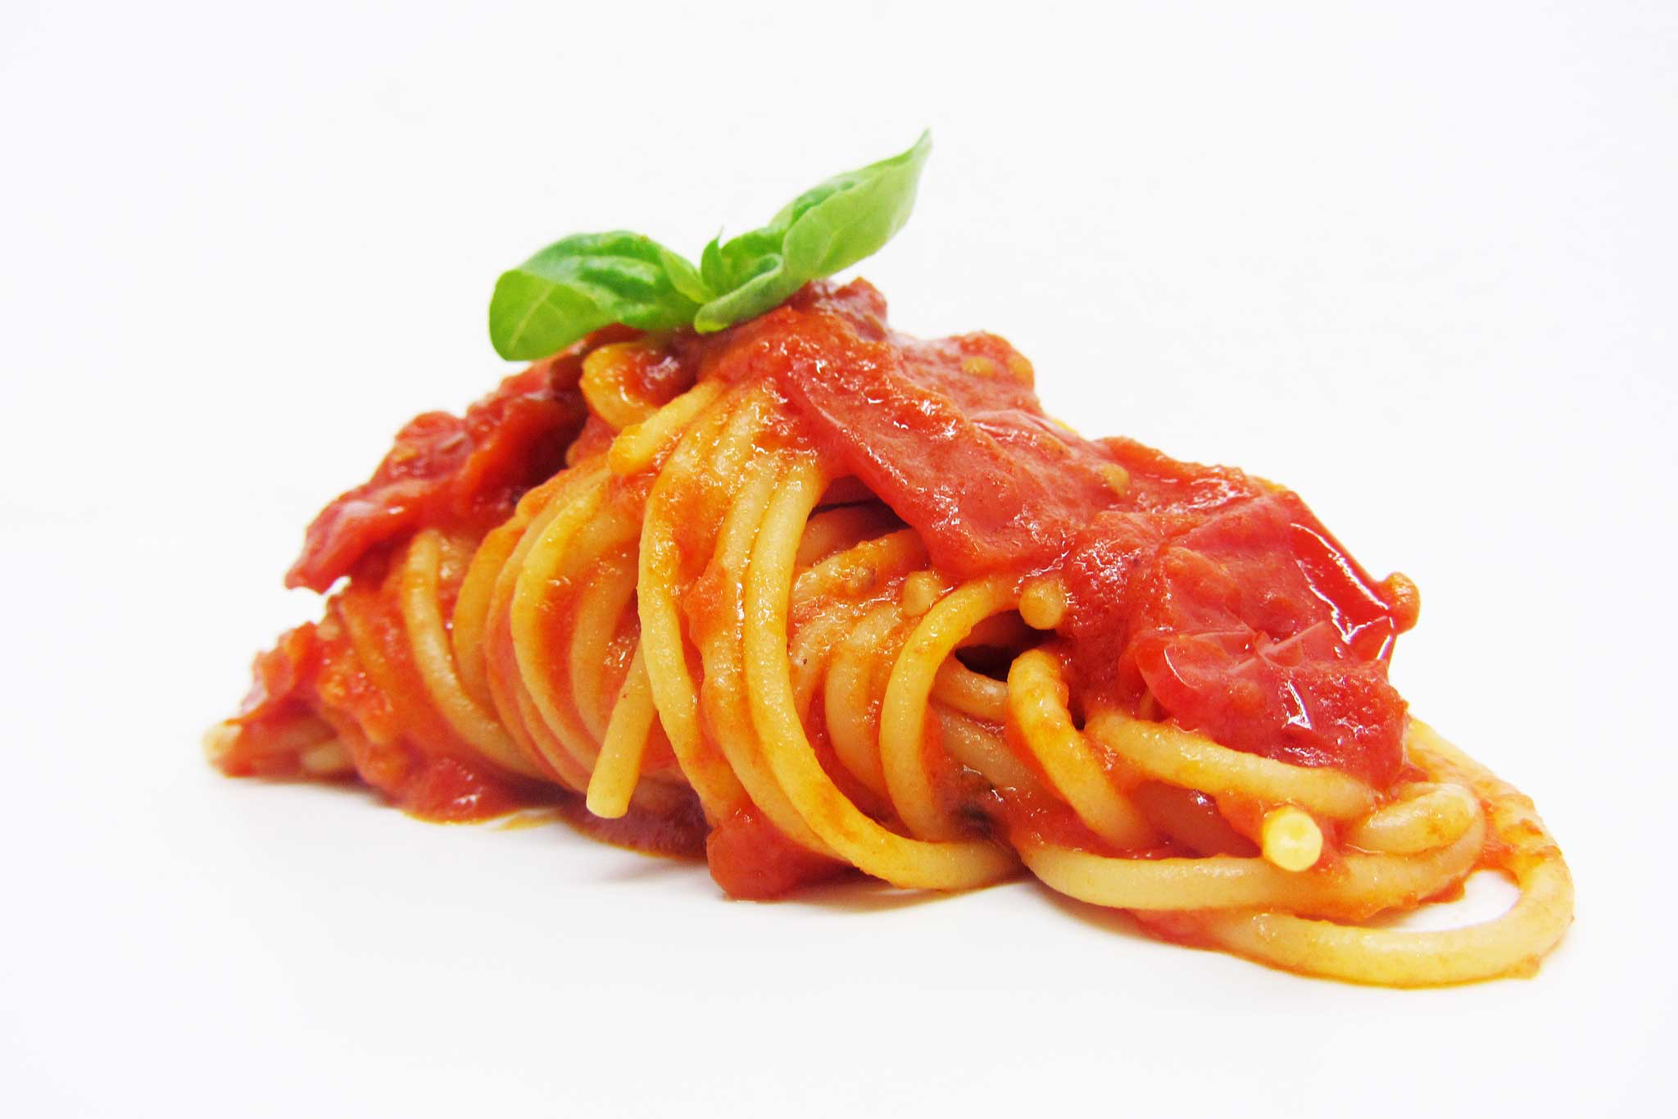
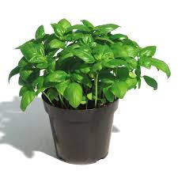

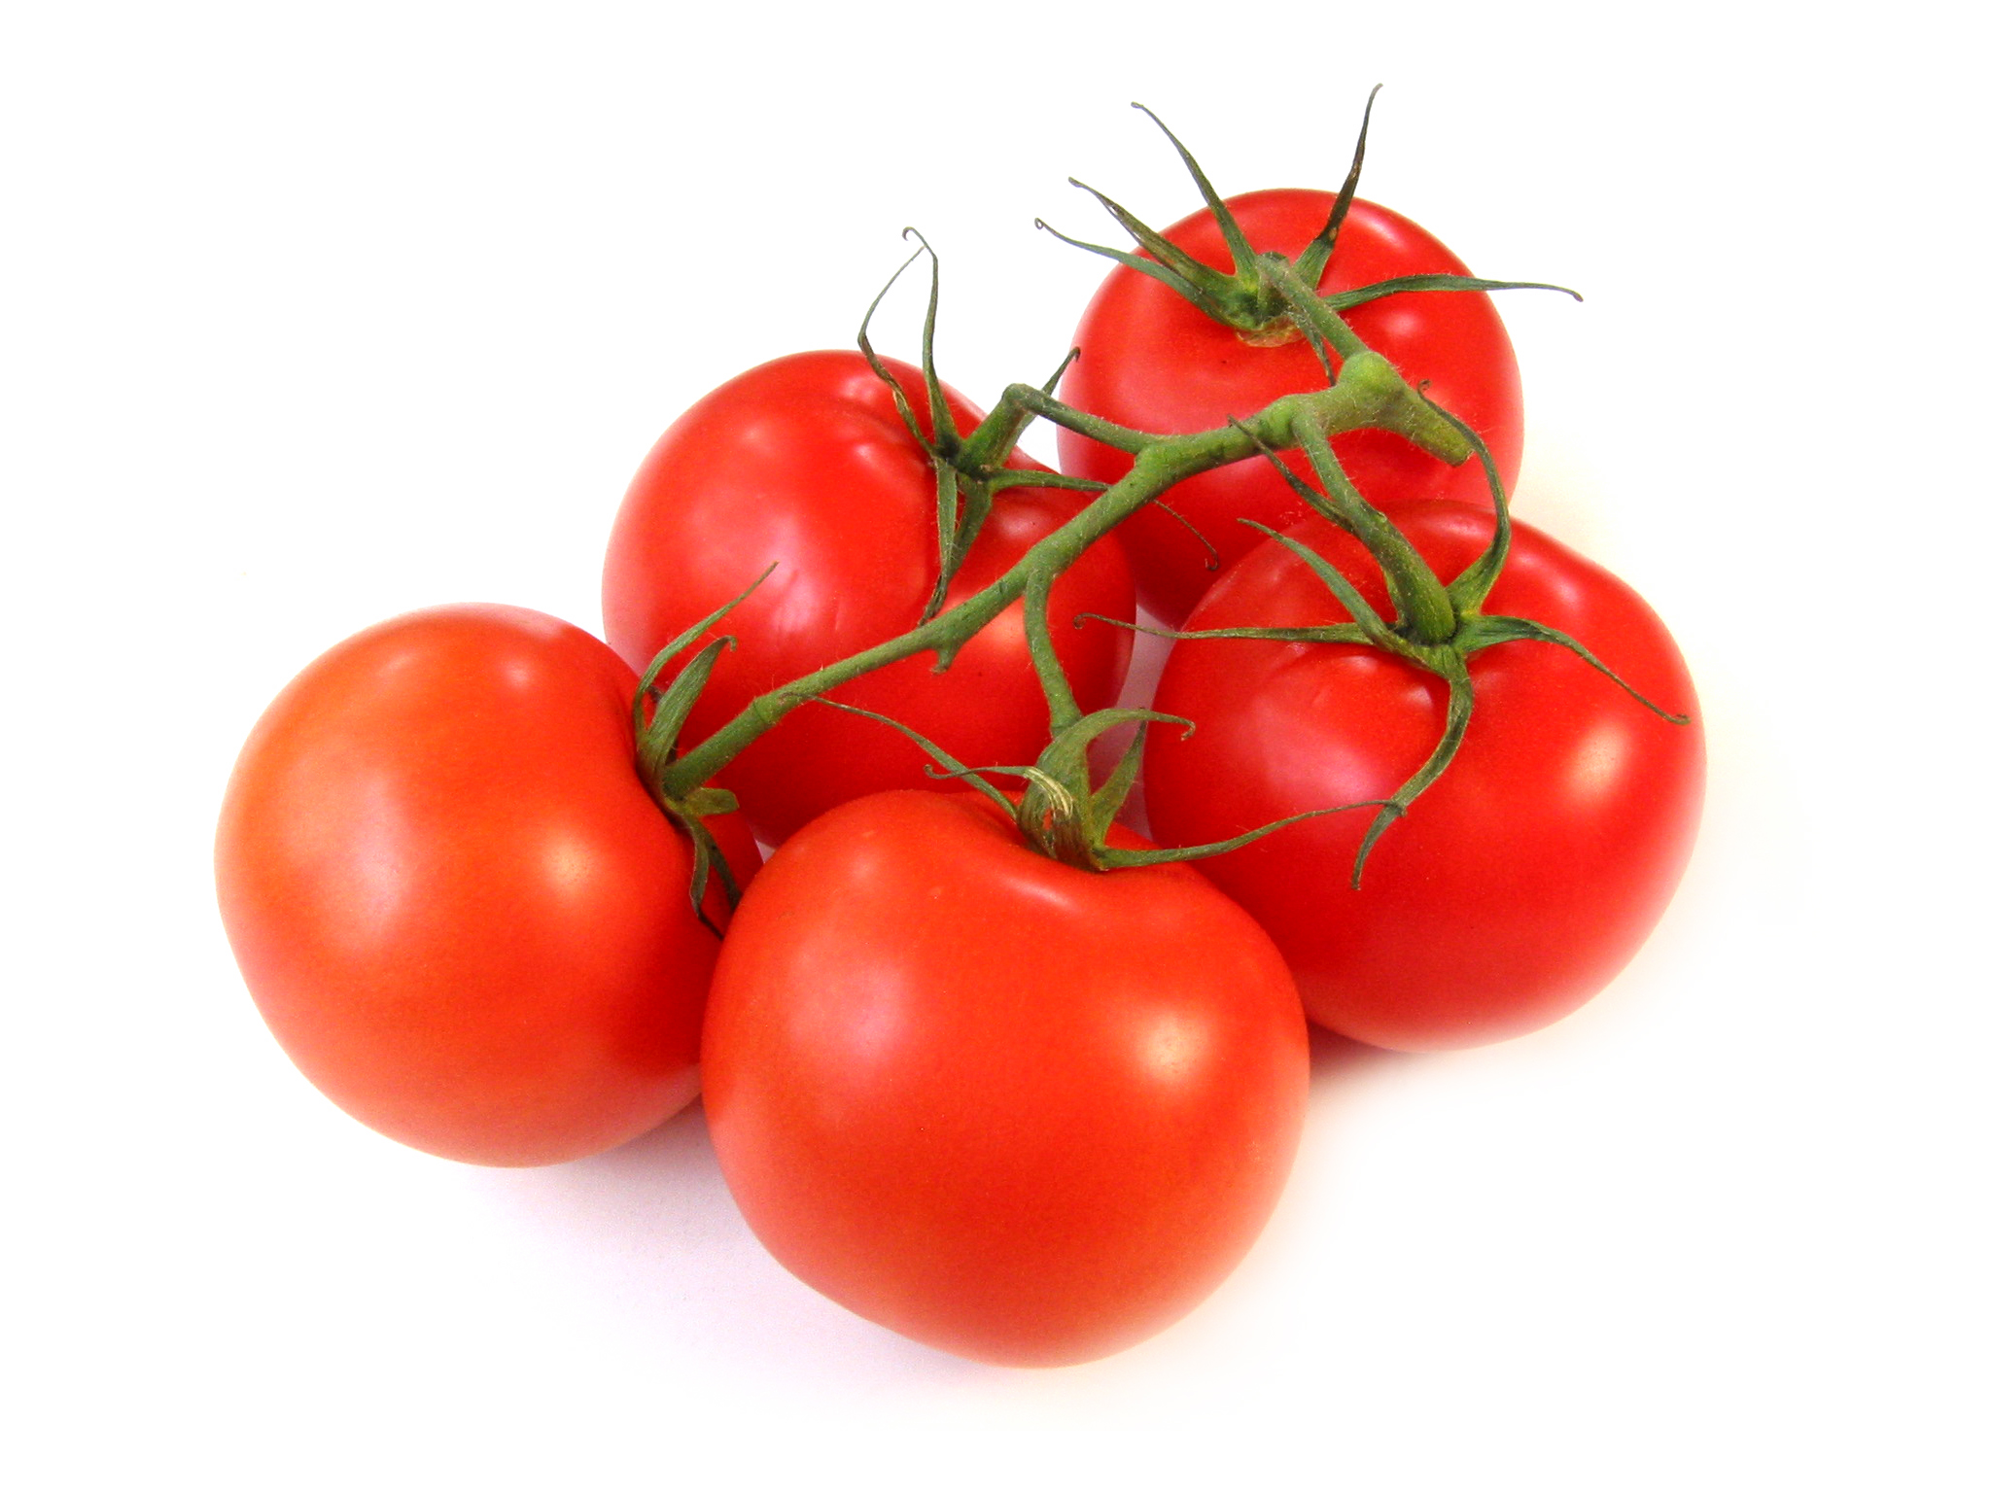
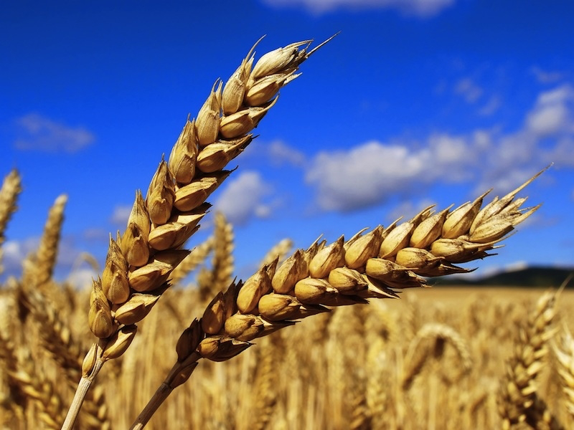
Complexity and Food
That’s what chef do every day

Slide 4
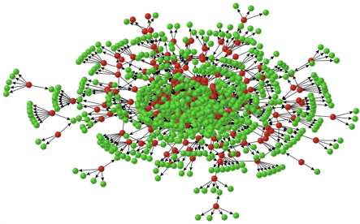
Complexity everywhere
Everything is related to interactions, so we need a model to describe them

Slide 5
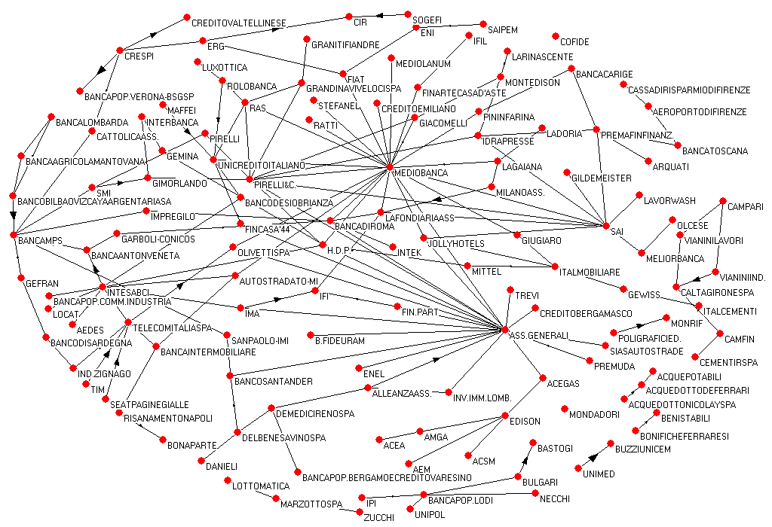
Networks show very well who matters and who doesn’t

Slide 6
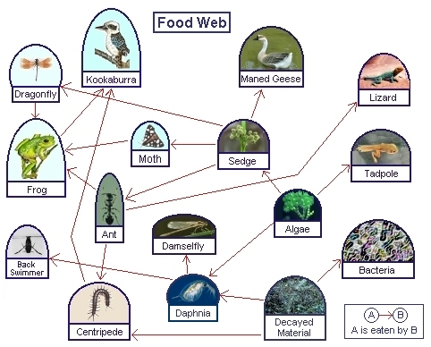
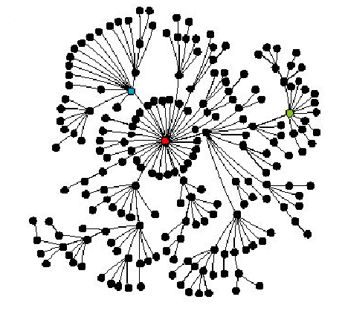
Complessità in Cucina
Complex Networks are ubiquitous and show some properties that are universal
Small world effect
Low diameter
Scale-free distributions
Degree does not show a typical value

Slide 7
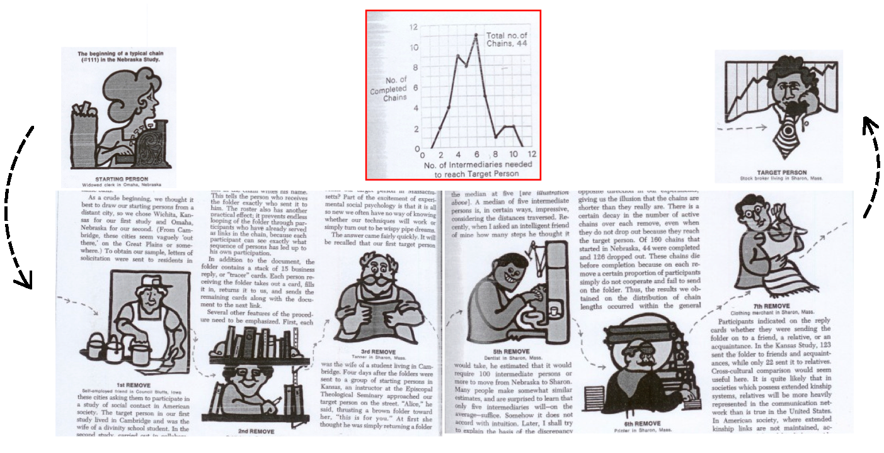
Small world

Slide 8
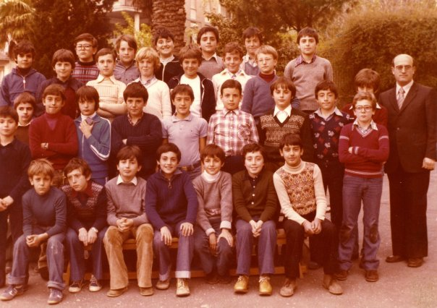
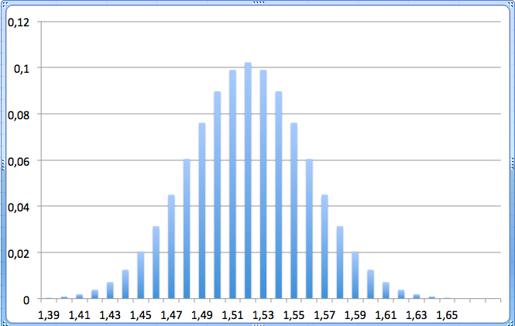
1978 Prima media (Roma)

Slide 9
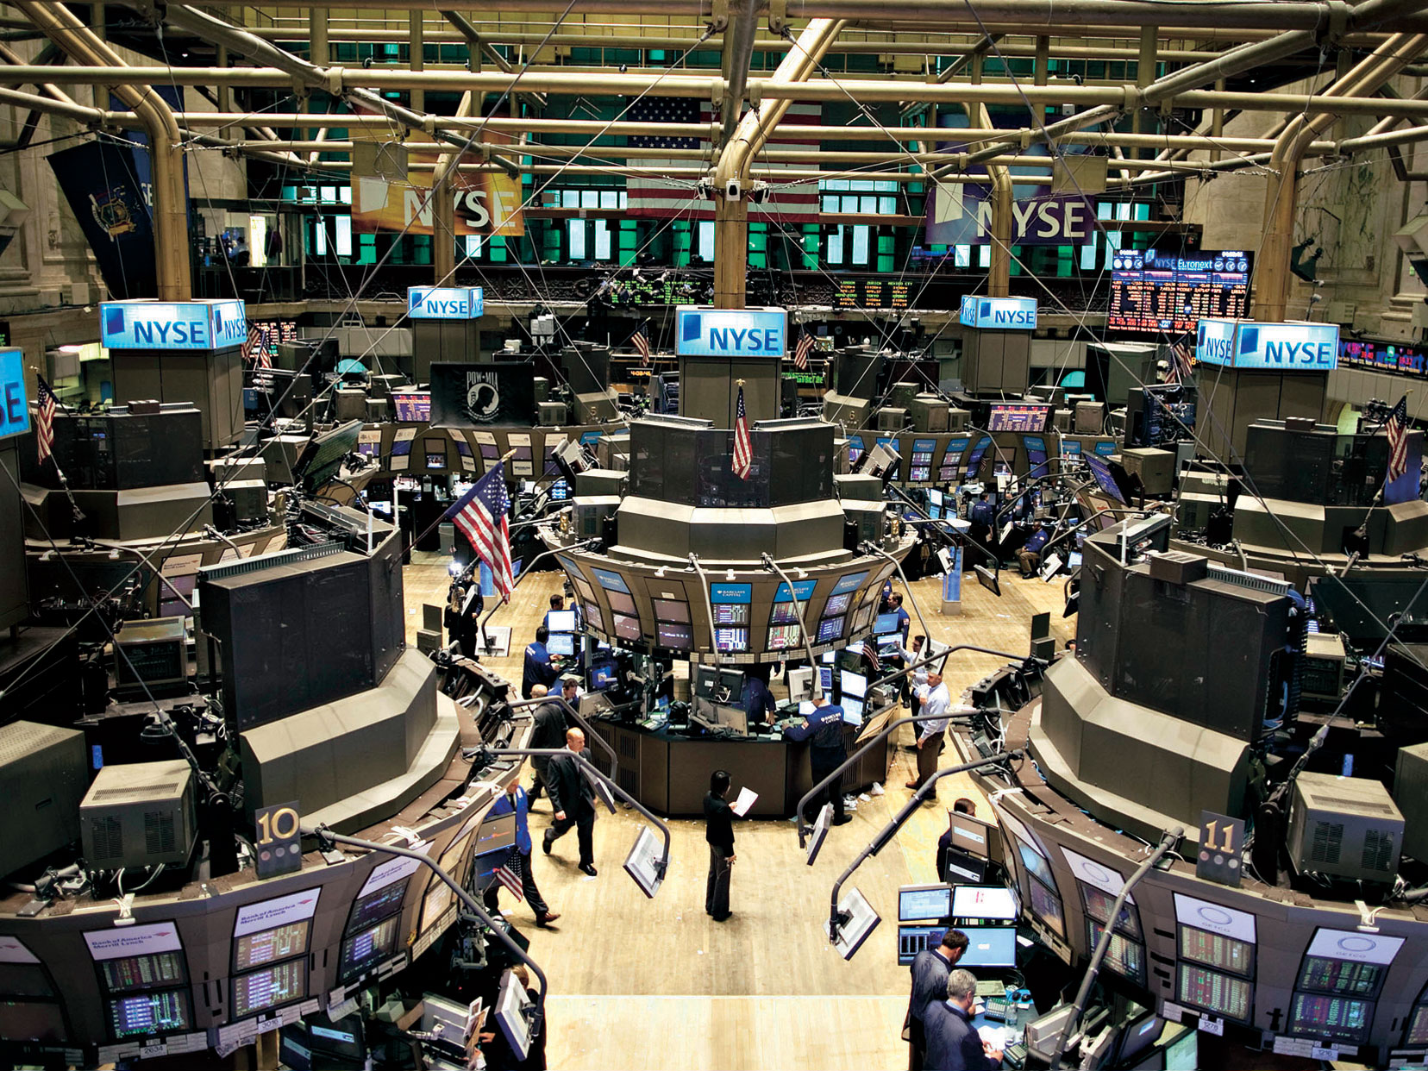
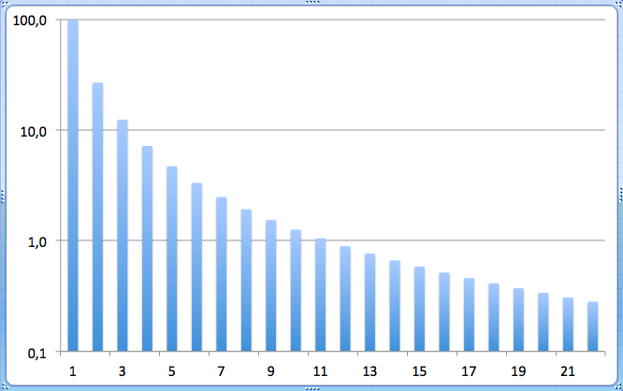
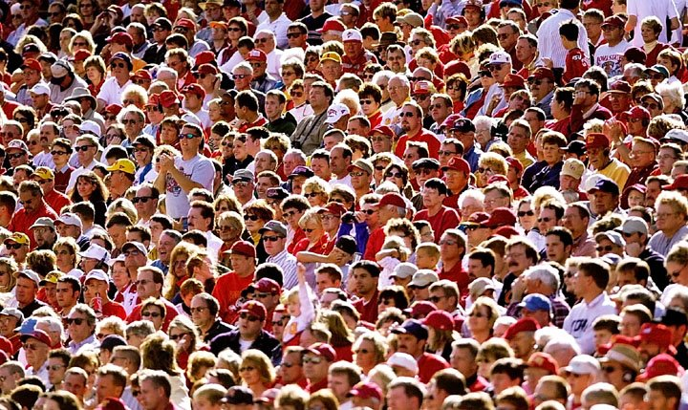

NYSE Everyday

Slide 10
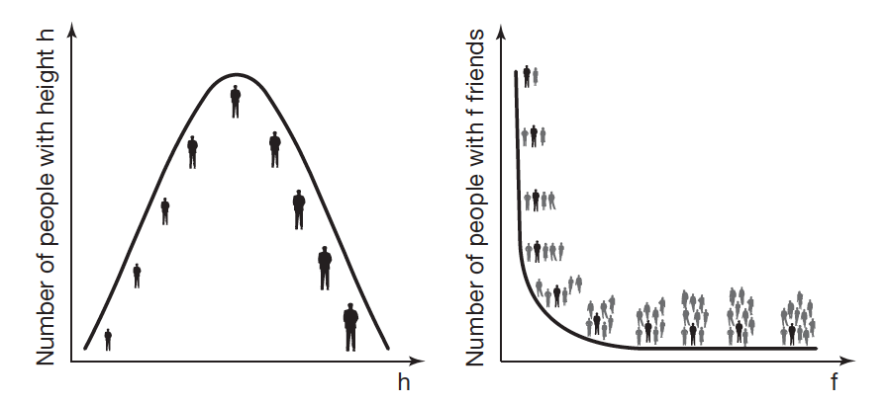
Scale-invariance
“Gaussian” (Poissonian)
Scale-free
Nobody 2 mm or 20 Km tall
One person might have 1000 volte more contacts friends/money than another one

Slide 11
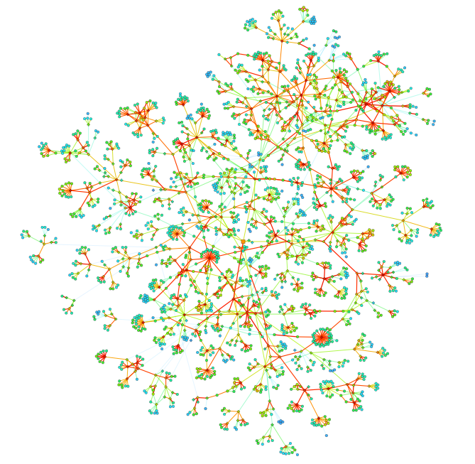
Reti di contatti
Every vertex is a phone number
Lines are calls

Slide 12
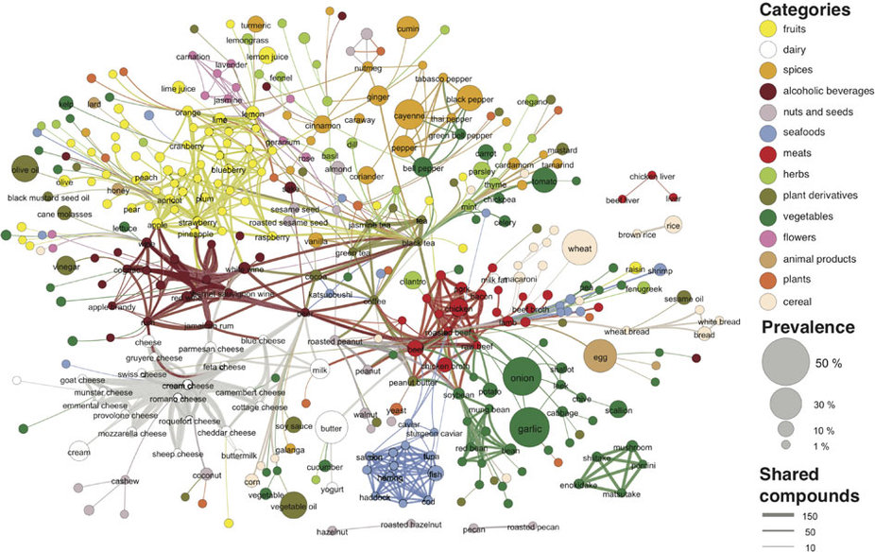
Complexity in Food

Slide 13
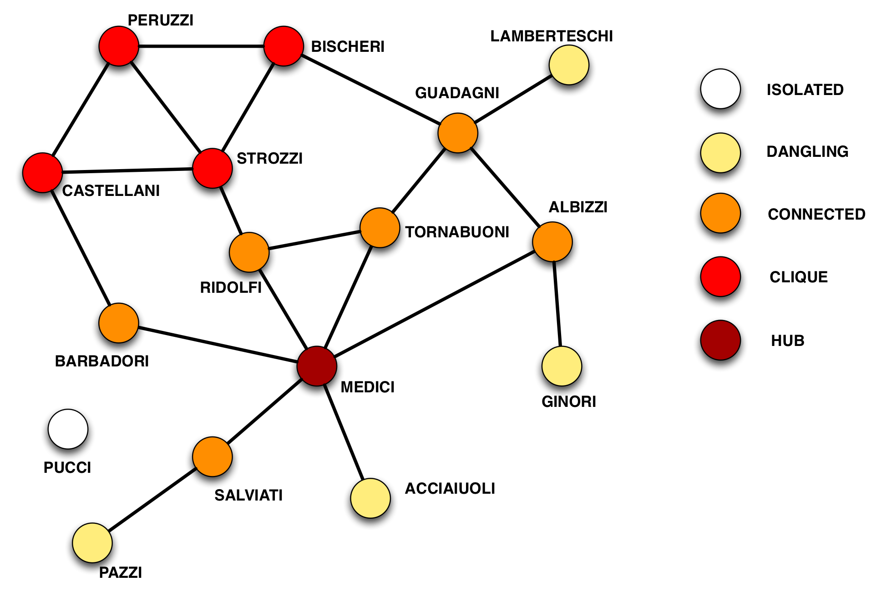
Complexity in Politics
Florence families in the Renaissance
Links are marriages

Slide 14
Reti e Cucina
NETWORKS VISUALIZE HIDDEN CORRELATIONS
At the moment Network entered in the food for
Flavour Networks
Ingredient Correlations
Product Networks

Slide 15
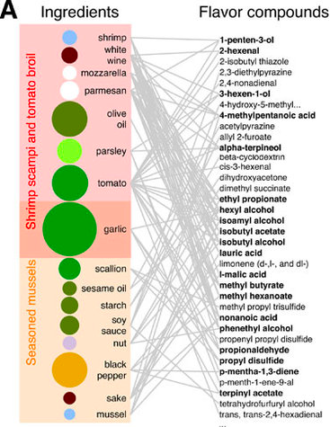
Complessità in Cucina
American Recipes
Shrimps, Mozzarella, Parmigiano …

Slide 16
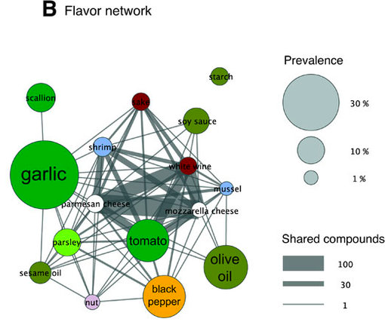
Complexity and Food
Posso unire due ingredienti se hanno “sapori” che si “sposano”

Slide 17
Complexity and Food

Slide 18
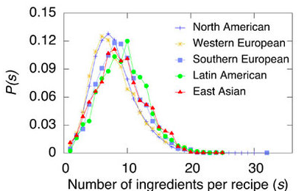
Complessità in Cucina
More or less same numbers but many differences :D

Slide 19
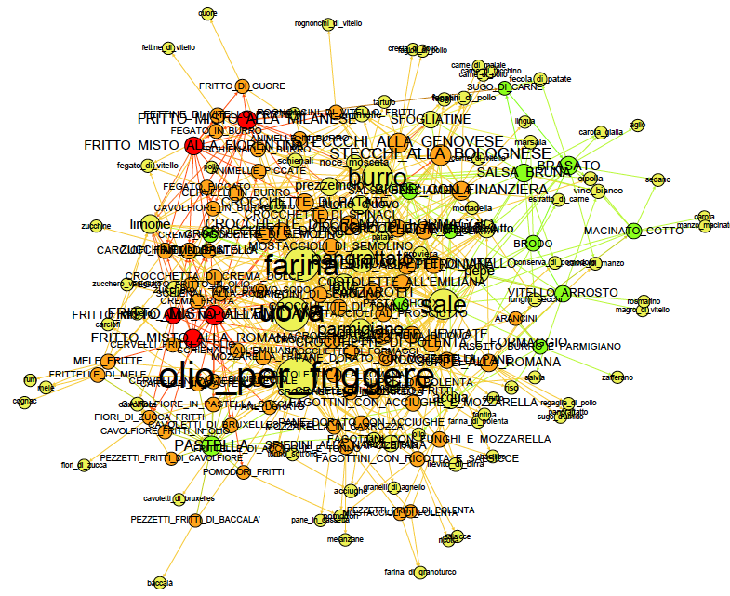
La Rete degli ingredienti

Slide 20
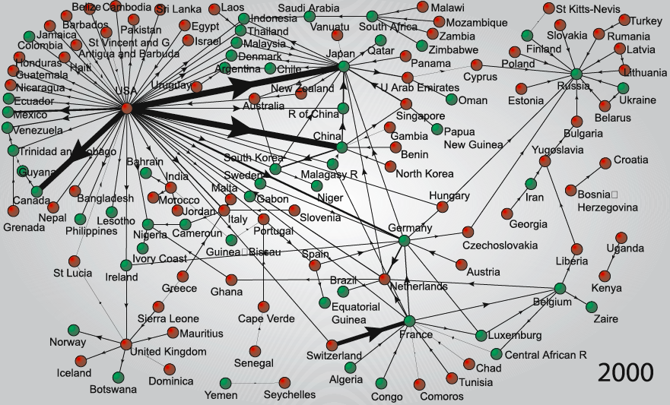
La Rete degli export

Slide 21
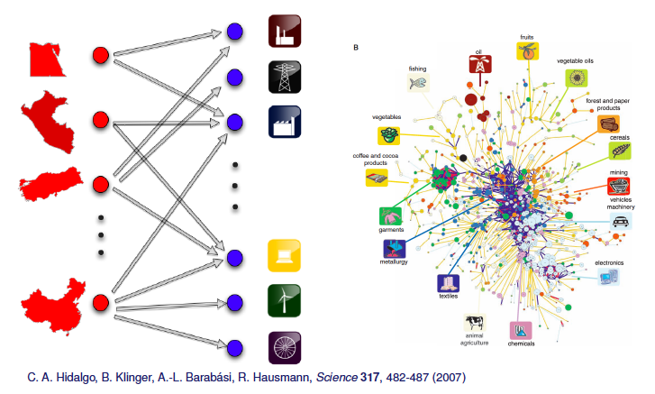
Country production

Slide 22

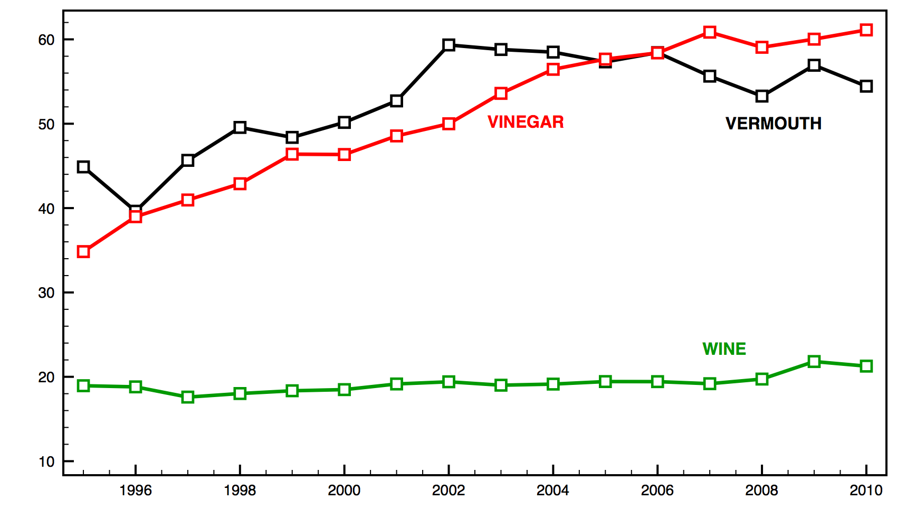
Winners

Slide 23
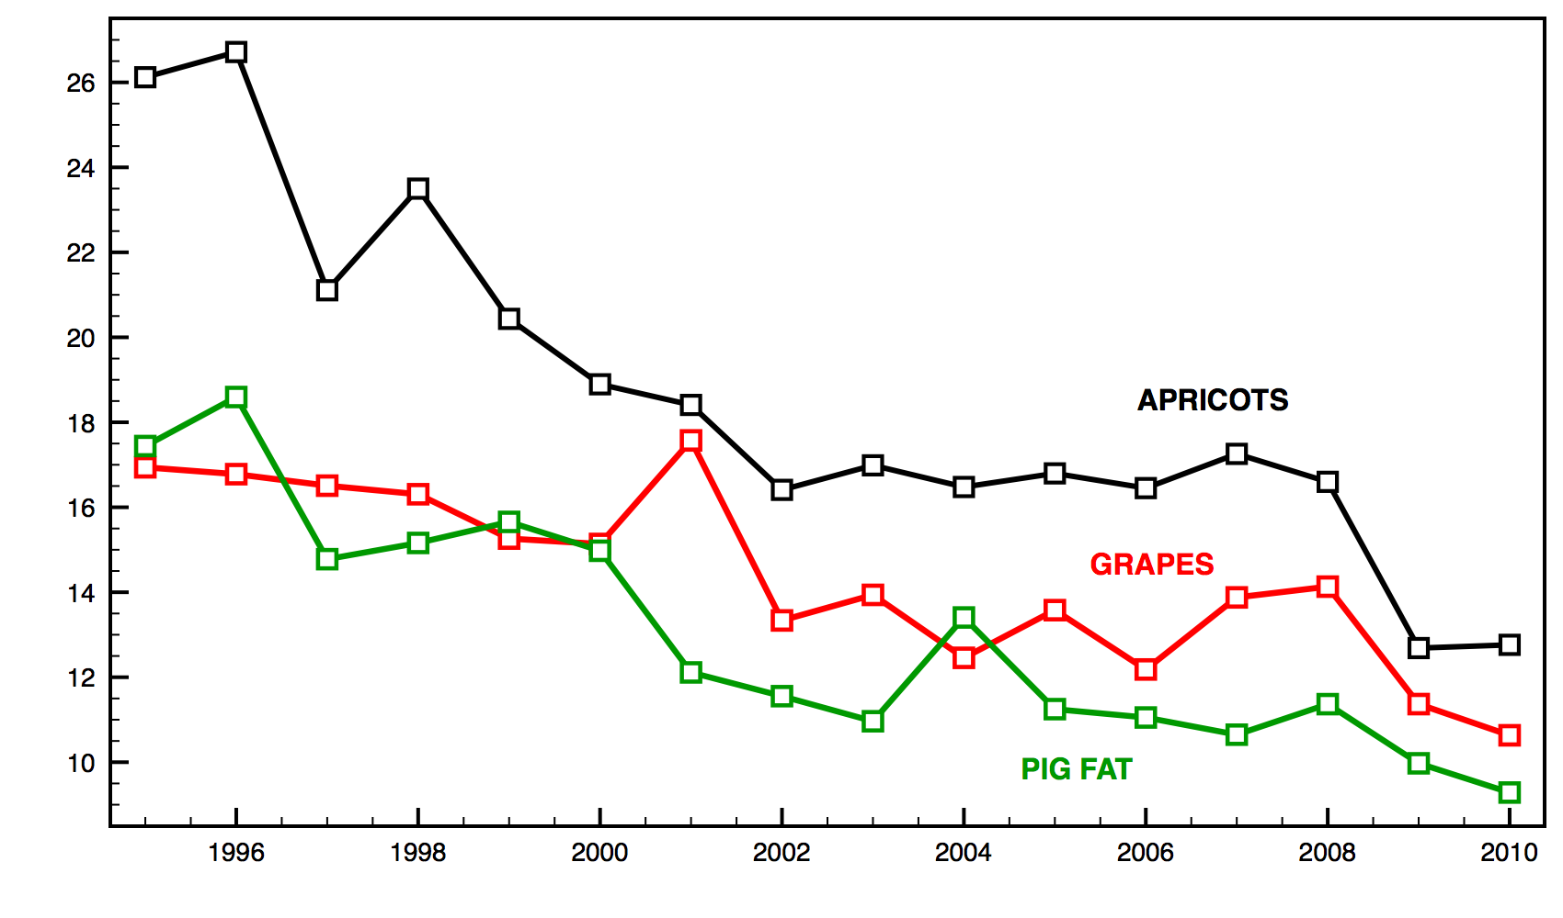
Losers

Slide 24

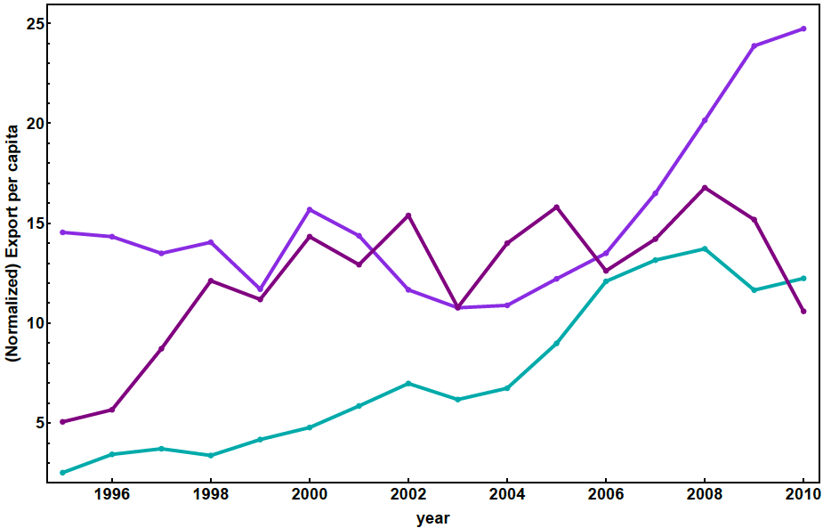

winners

Slide 25
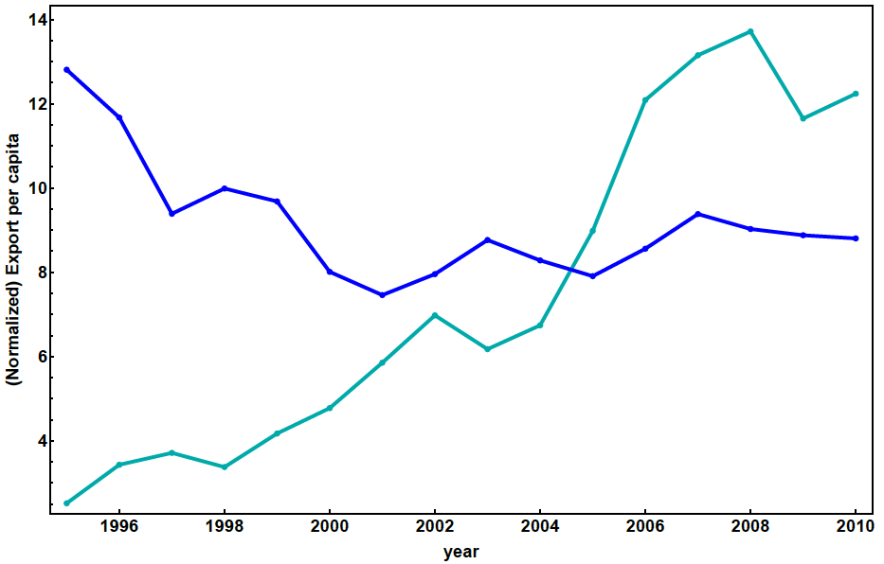

winners

Slide 26
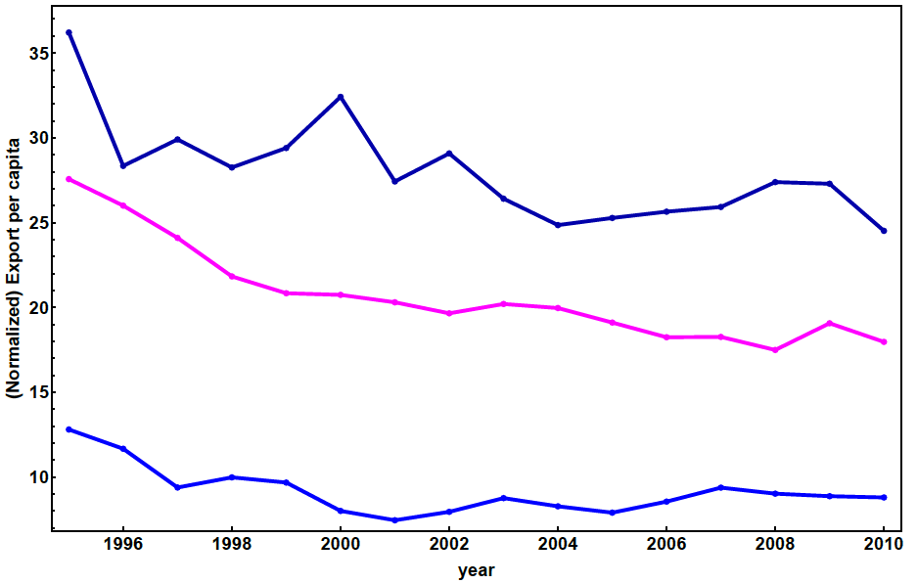

Losers

Slide 27
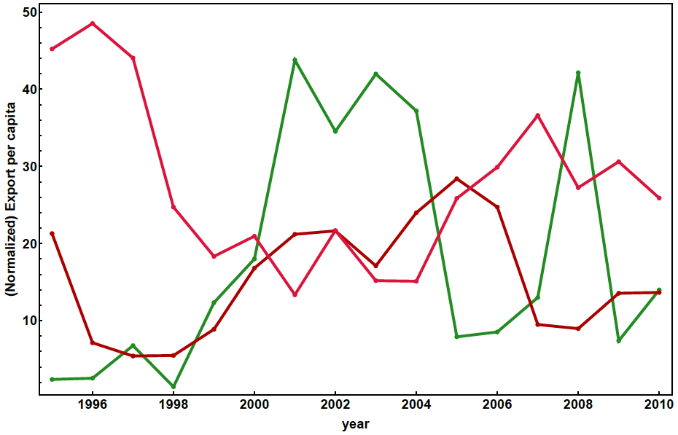

Oscillating

Slide 28
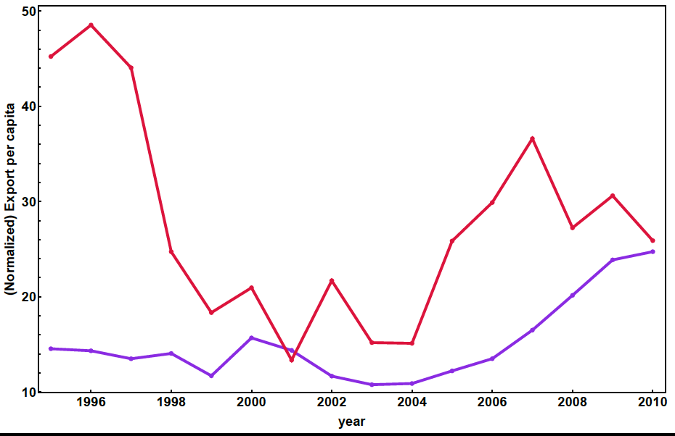

Oscillating

Slide 29
CONCLUSIONI
Le reti sono dappertutto ed hanno sempre le stesse proprietà
Le reti visualizzano rapidamente cosa succede nel nostro sistema
Le reti ci guidano nel mondo in cui viviamo
Le reti possono aiutare a capire cosa passa per la testa di un grande chef

