Slide 1
GLOBALIZATION AND GASTRONOMY
IICM, Mateus, Portugal
25-27 Nov 2016
Gastronomy – a strong cultural and creative resource for regional development
Jannie Vestergaard
Skåne Food Innovation Network /Taste of Skåne
jannie.vestergaard@livsmedelsakademin.se
tel. +46 727 348544
SoMe: Twitter: JanniesTweet, Instagram: JanniesInsta, LinkedIn: Jannie Vestergaard

Slide 2
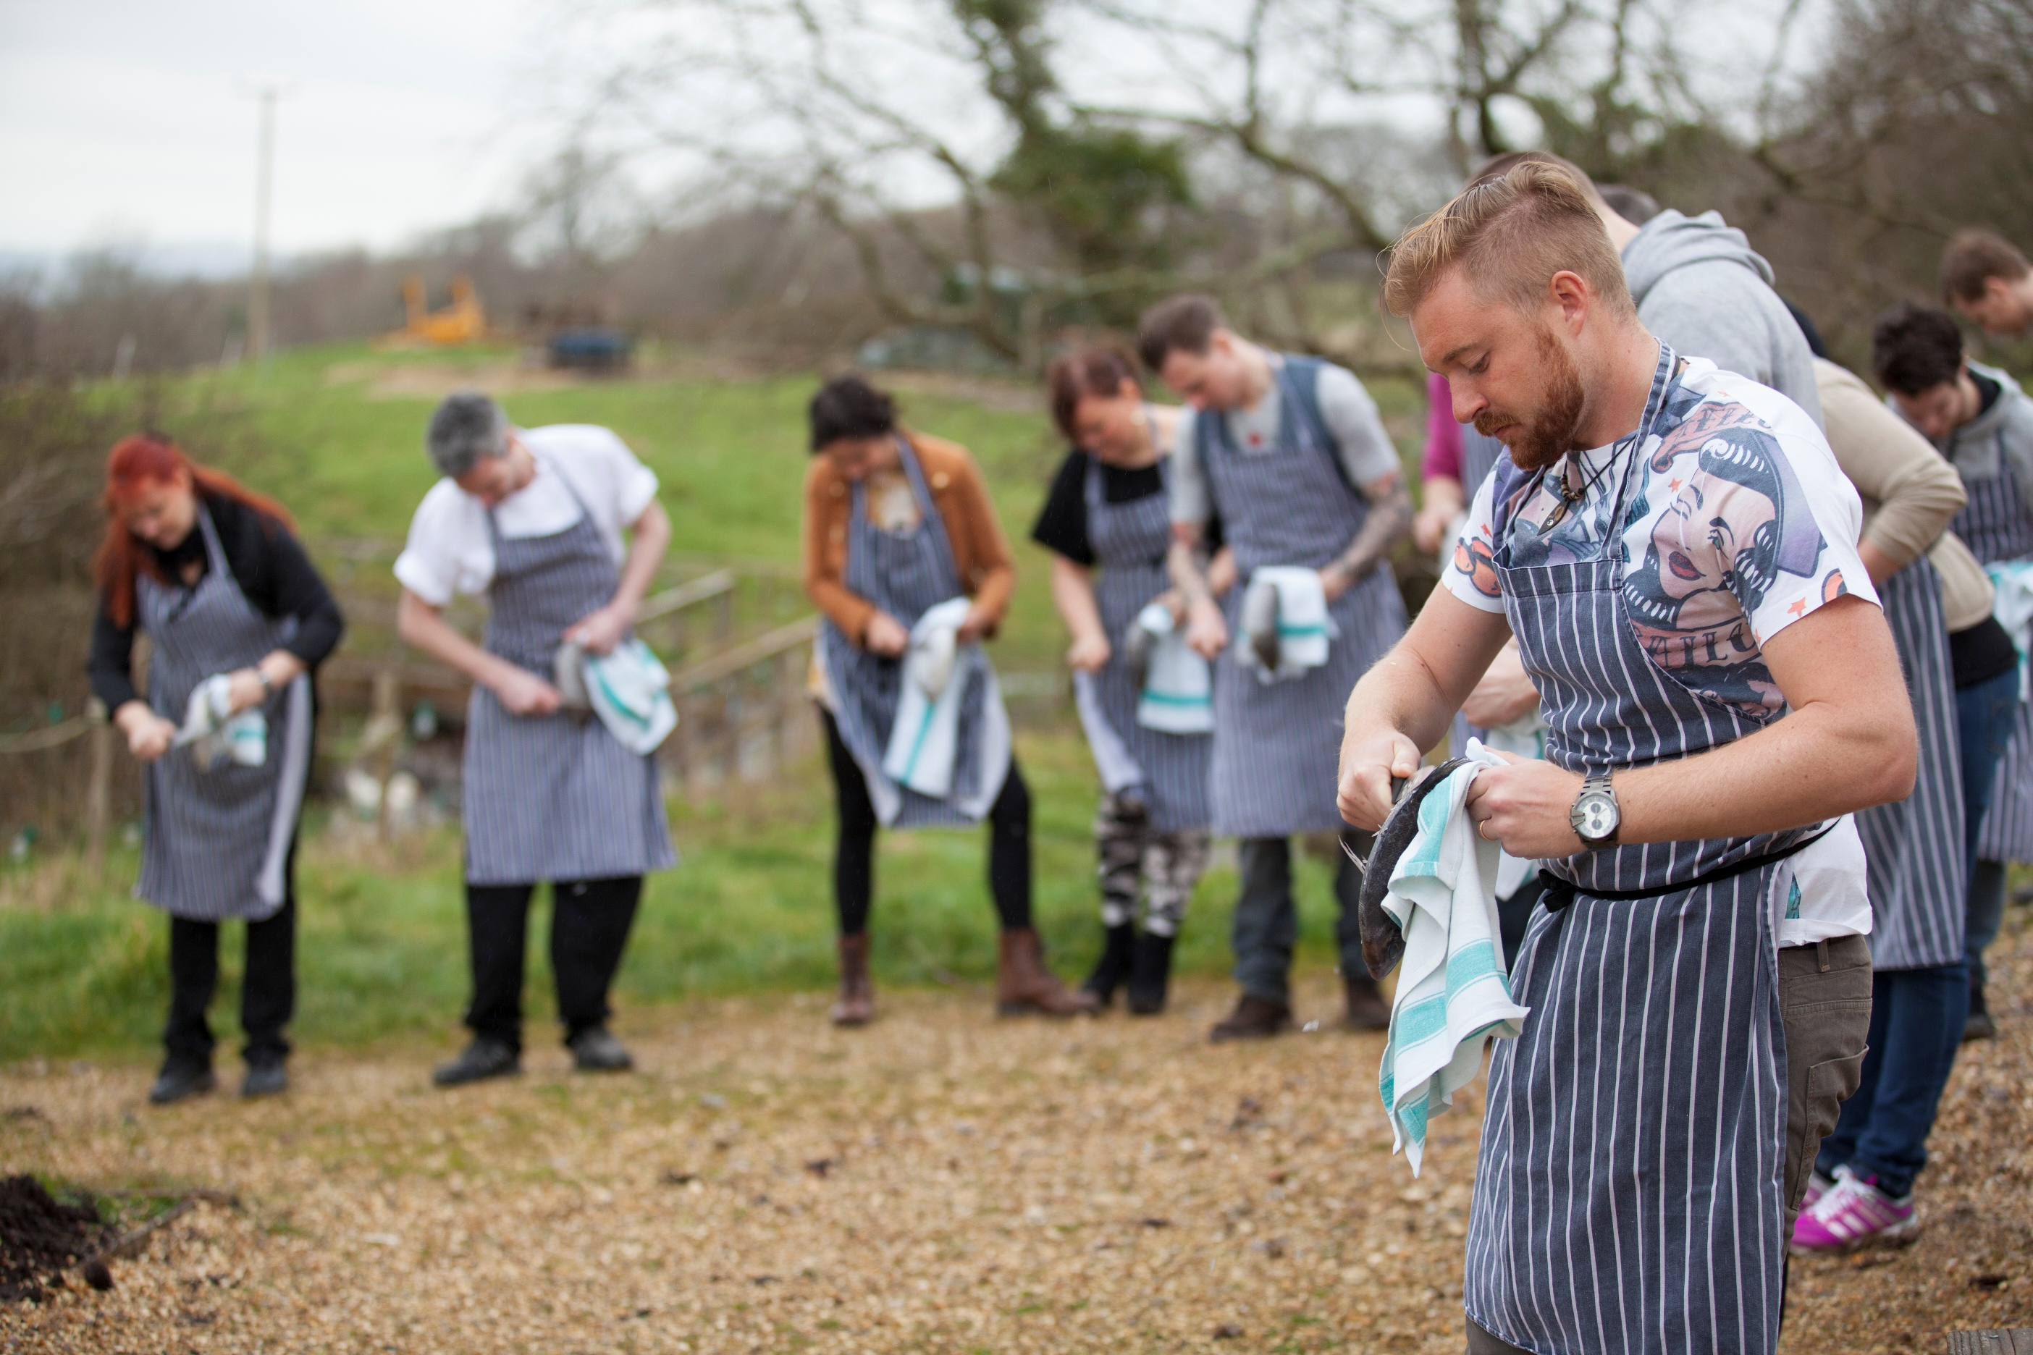
”Skåne – a strong culinary region”

Slide 3
Regional development: from visions to public
investments, policies and summing it all up
in a food festival!

Slide 4
…or how to stimulate creativity for obtaining
a sustainable food system
and thriving rural communities…

Slide 5
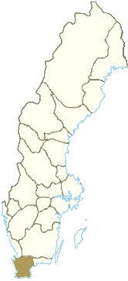
Skåne a region of diversity!
Southern most region of Sweden covering 10 900 km2 (approx 2,5% of the total area)
1,3 mio inhabitants (approx 13% of the Swedish population)
OECD report (2012): Skåne #4, food ranked high as an innovative area
Main cities Malmö (SW), Helsingborg (NW), Lund (SW), Kristianstad (E), Landskrona (NW)…and remember Copenhagen is closer (than Stockholm)
Skåne is very diverse with more than 170 nationalities alone in Malmö
The food sector
  30+ large scale companies, almost all with global owners
  850 small scale companies and artisinal producers
The landscape is also very diverse – ”everything” is grown here
21% of the turnover in Swedish agriculture
38% for vegetables and fruits, 25% for food and beverages
4 Michelin restaurants (*, new since 2015)
4 000 restaurants and hotels

Slide 6
What’s Skåne Food Innovation Network about?
SFIN building the innovative landscape for future food, drinks and meals
A business driven food cluster with strong connection to regional universities and the public sector – so called triple helix structure
Providing conditions and facilitating entrepreneurship and innovation
Connecting smaller and bigger stakeholders together driving questions bigger than single stakeholders can solve alone
Creating meeting places and arenas for our networks
An association with around 45 partners and 100 members
Established in 1994. Public and private financing

Slide 7
A strategic choice.
…County Administrative Board of Skåne
… Skåne Regional Council
…associations and other stakeholders
…entrepreneurs and small scale food producers
Gathering stakeholders and optimizing resources in order to get
more power behind innovation and development activities…

Slide 8
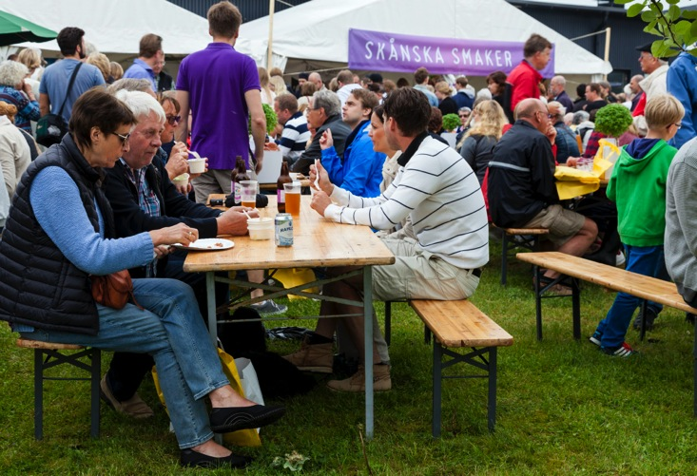
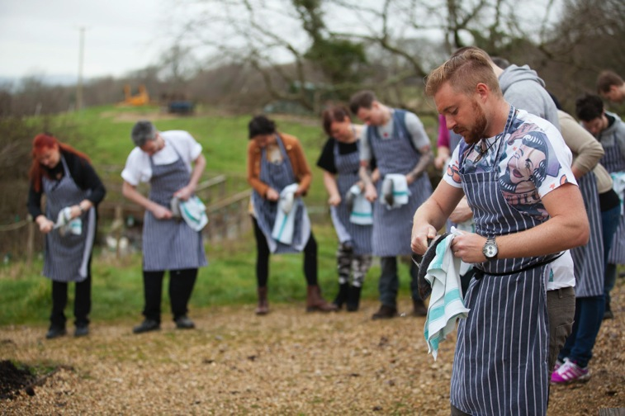
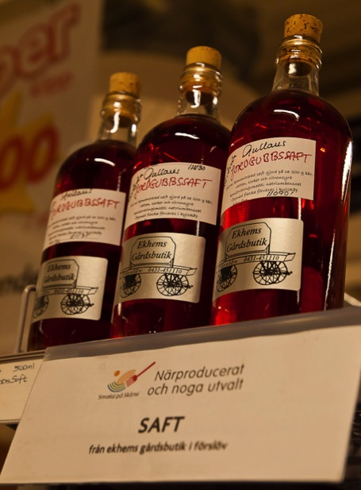
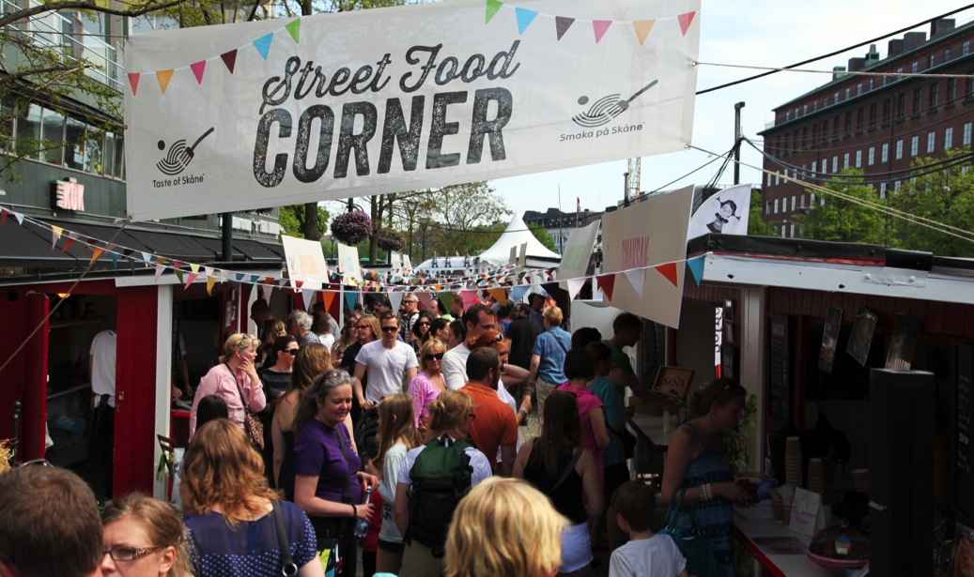
Notes:
OBS! Följ grafisk profil. Använd typsnitt Futura Book i all text. Fyll ej sidorna med text. Använd skarpa foto i klara färger från vårt bildarkiv. Var noga med stavning, radera dubbla mellanslag och undvik dubbla radbrytningar. Vid problem kontakta Cecilia Franck, 0735-979743. Hon hjälper gärna till! ☺
Introbild innan presentationen börjar.

Slide 9
What’s Taste of Skåne about?
Working for Skåne to be recognized for its food and drinks
of high quality based on the landscape, culture and history
Developing Skåne as a culinary region
The umbrella for developing Skåne into a strong culinary region
  small scale production
  culinary tourism
One of three main development and innovation actors in Skåne for small scale production and culinary tourism
Creating Identity and Proudness!
Our mantras: Increasing visability, accessibility, quality and cooperation
Sweden’s largest food related project in the previous EU period (23 mio SEK)
Taste of Skåne is part of Skåne Food Innovation Network

Slide 10
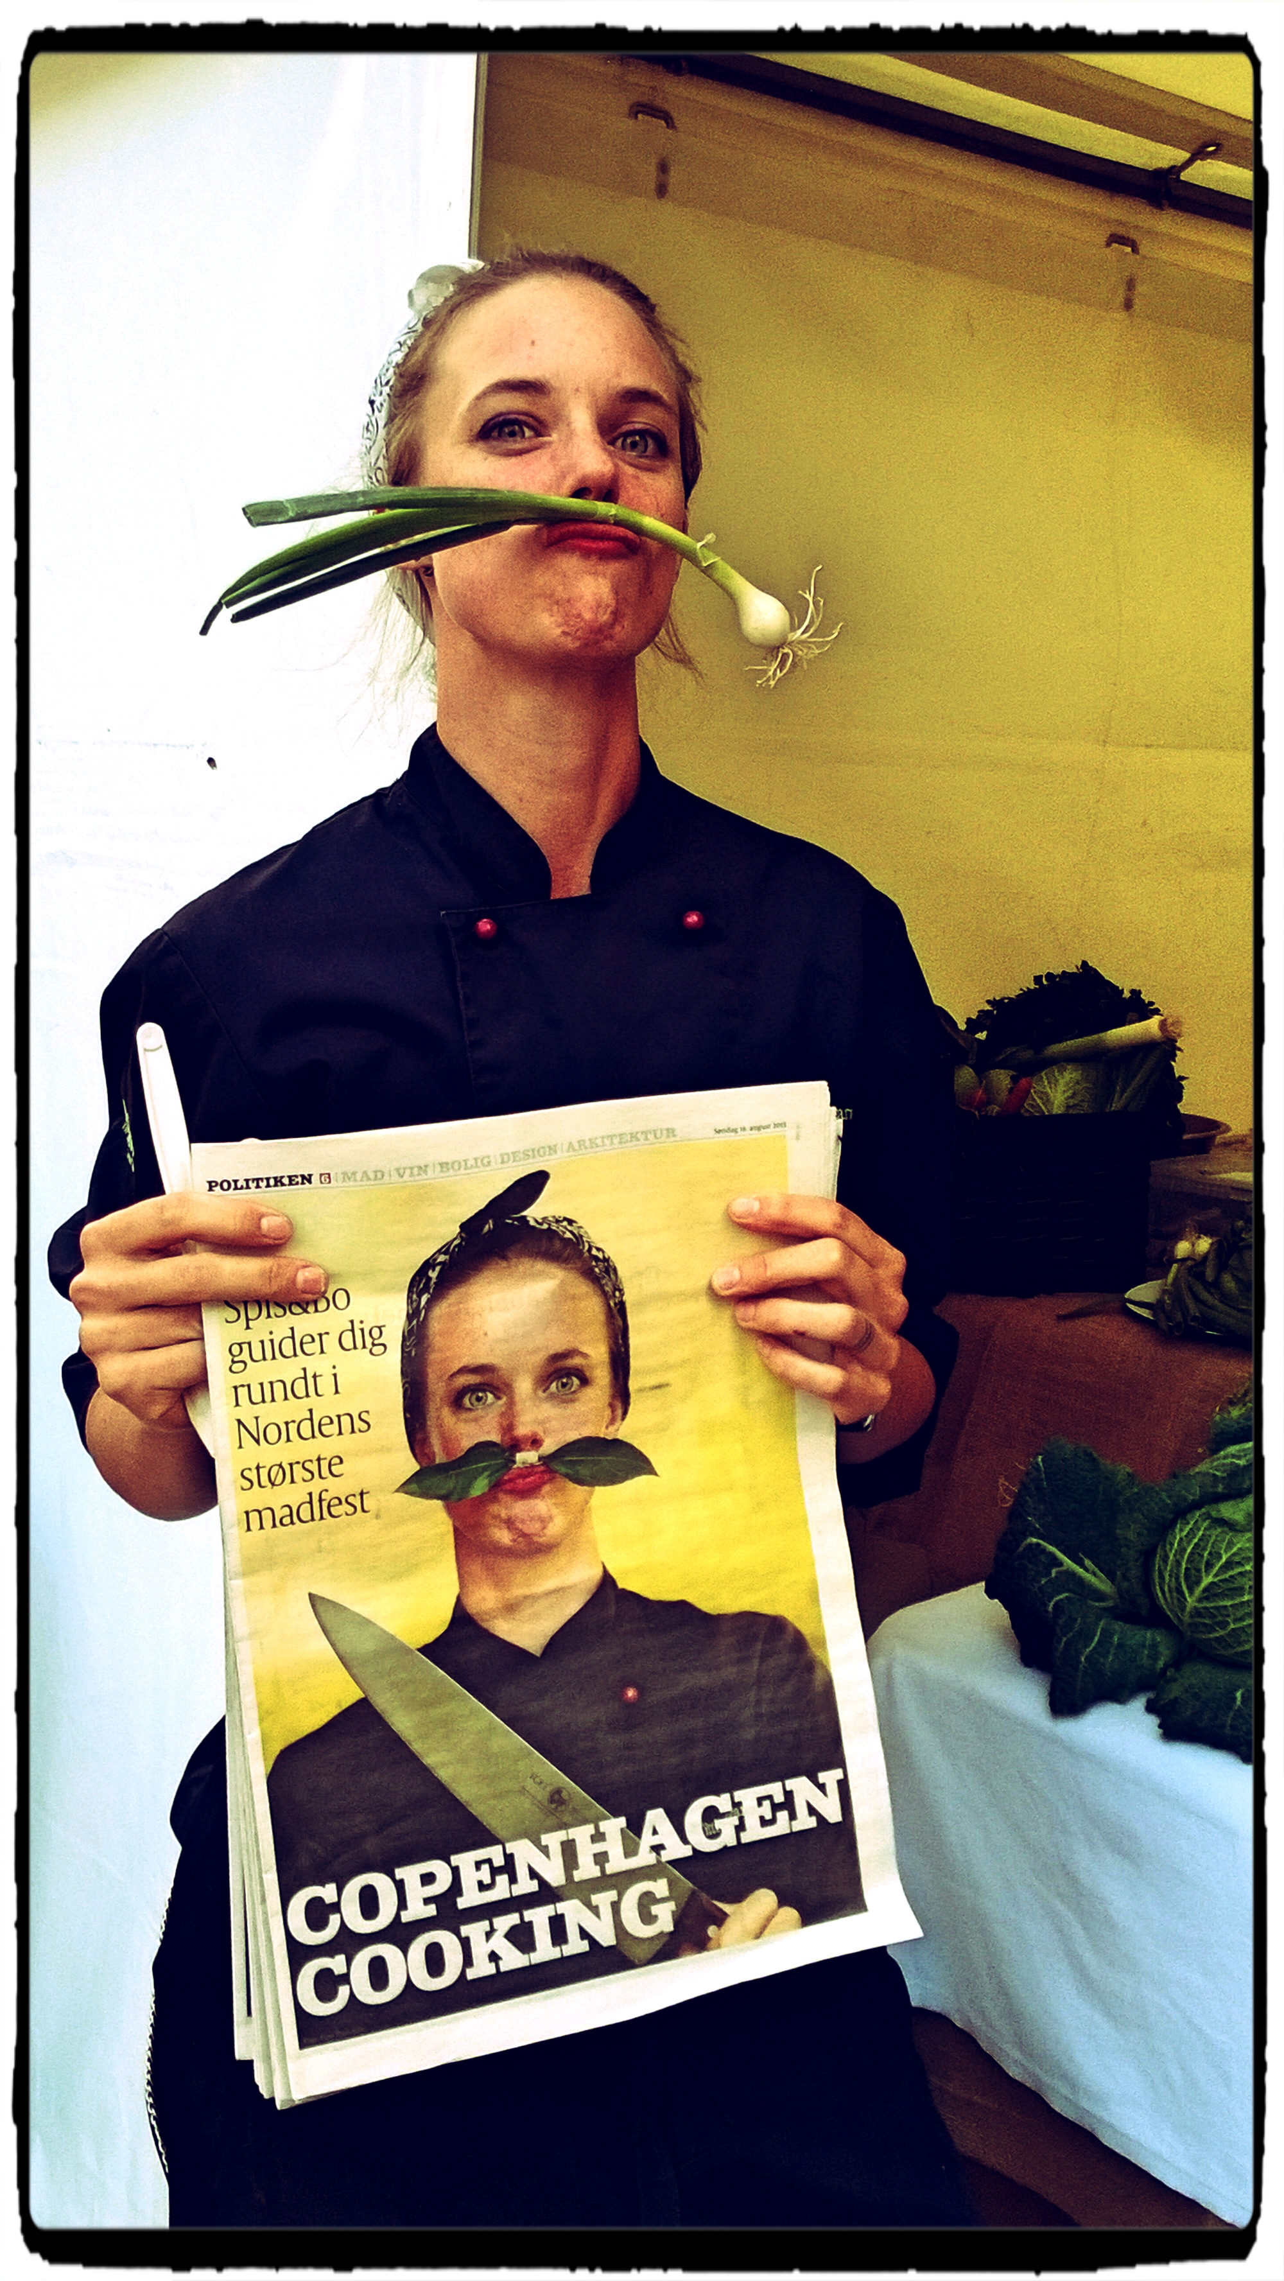
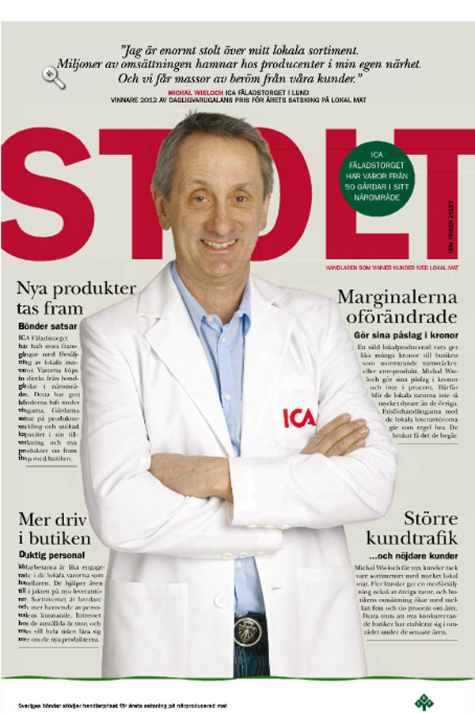
Identity and Proudness. The sense of place. Passionate people.
Sweden’s first female
Michelin chef,
Titti Qvarnström of
Bloom in the Park, Malmö
Supermarket owner
Michal Wieloch from Lund.
Providing everyday
local food to the customer

Slide 11
Our mantra. Our model.

Slide 12
Scenprogram
Samlingsplats
Seminarier
Matmässor
Studieresa
Speeddating
Sydsveriges bästa golfkrogar
Rådgivning
Malmöfestivalen
Handlarråd
Nya Skånska Köket
Kompetensutveckling
Förpackning och design
Handlare
Smakupplevelser
Matverk
Strategi
Street food fika
Through visability, accessibility, quality and cooperation
developing Skåne as a culinary region
Skånsk Street Food
Kunskapsdagar
Handlarnätverk
Matvandring i butik
Butiksskyltning
Coachning
Älska Mat & Vin
Matfestivaler
Producentgrupp
Kulinariska utflyktsmål
Kunskap
Inspiration
Workshops
Aktiviteter
Möten
Skånska drycker
Skånsk dryckesbar
Matfestivaler
Producenter
Småskaliga matproducenter
Kurser
Notes:
Målet är att Skåne ska vara en kulinarisk frontregion 2025. Och vad är då en kulinarisk frontregion? Jo det är en region som har unika råvaror och produkter som utmärker regionen, en stolthet, en tydlig identitet, ett starkt entreprenörskap, en vilja att utvecklas, en gemensam historia och en attraktionskraft som gör att turister gärna besöker regionen för att uppleva maten och drycken.

Slide 13
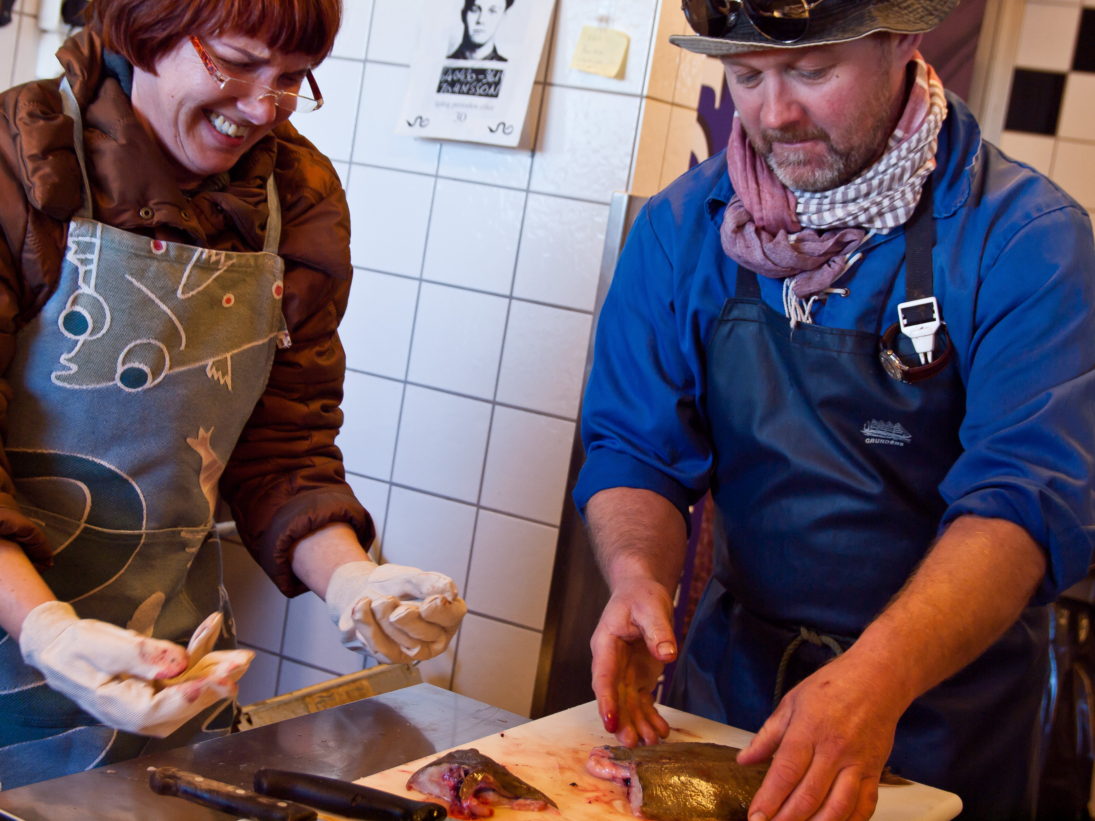
Skills in all parts of the system,
business models/concepts.
Networking, cooperation – soft values!

Slide 14
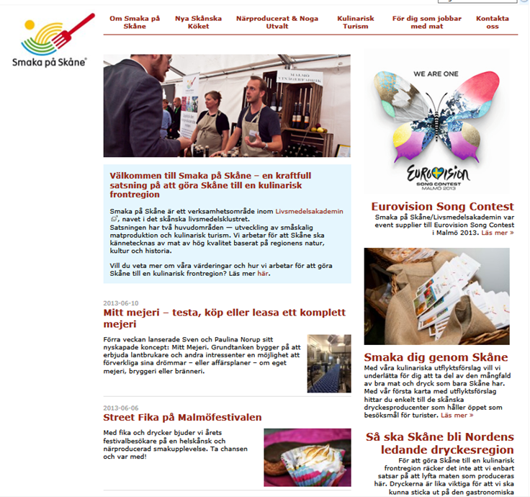
Focus areas.
Concept for exposing
local food in shops and supermarkets
Culinary Tourism
The New Skåne Kitchen
Beverages
Export
Local food in public sector
Conceptualising food for events (that are not food related…)
Street Food
Skåne Food Festival 2014-2016

Slide 15
Four examples.

Slide 16

1. A strategy: ”Skåne the leading Nordic region of drinks and beverages 2020”
During 2012-2013 the strategy was developed in cooperation with stakeholders; seminars, interviews, statistics etc.
The main purposes and goals of the strategy:
To develop and define the Skåne terroir and uniqueness
To strengthen the growth in the sector
To increase jobs and employment in the sector
A common tool for priorities of public resources
Can be implemented overall for food!

Slide 17
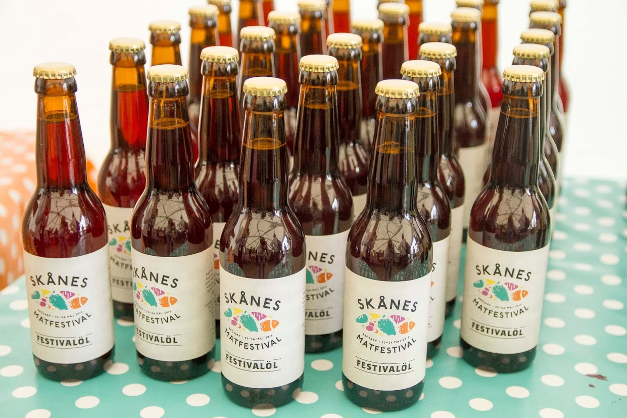
”Skåne the leading Nordic region of drinks and beverages 2020”
6 Focus areas:
  Uniqueness
  Excellent Raw Material
  More Processed Beverages
  Retail & Restaurant
  Creating First Class Destinations
  Beverages in the Public Sector
Skåne inhabitants should be proud, know of and buy local beverages

Slide 18
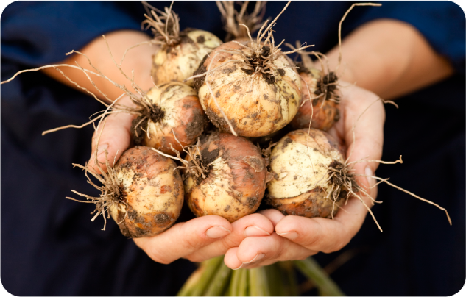
2. A concept: ”Taste of Skåne – locally produced and carefully selected” – our retail concept celebrating 5 years in 2016

Slide 19

The message is simple…
Locally embedded
Accessibility
Exposure
Visibility
Meets a strong trend
Possibility for increased sales

Slide 20
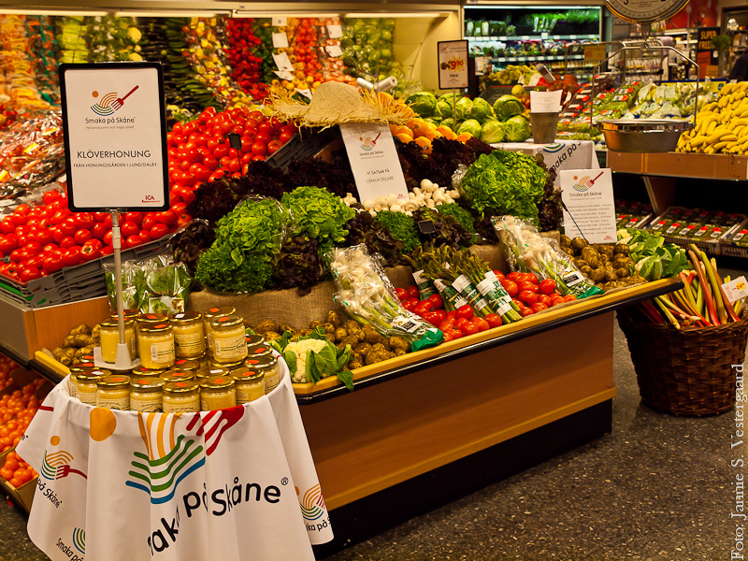
In a nutshell
Retailer’s network
Retailer’s council
Neutral arena:
open to all kind of shops
44 shops
Simple criteria
Webb education
Retailer is the guarantee
240 employees w diploma
Accesibility of market channels
Developed in cooperation with our Retailer’s council

Slide 21
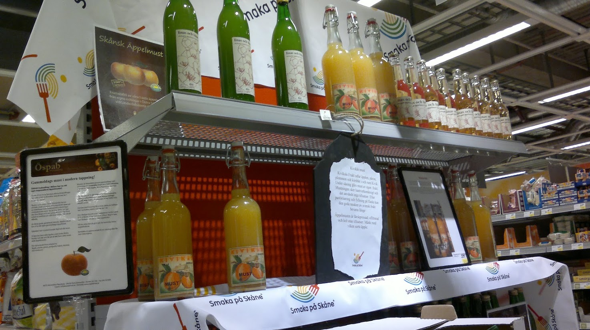
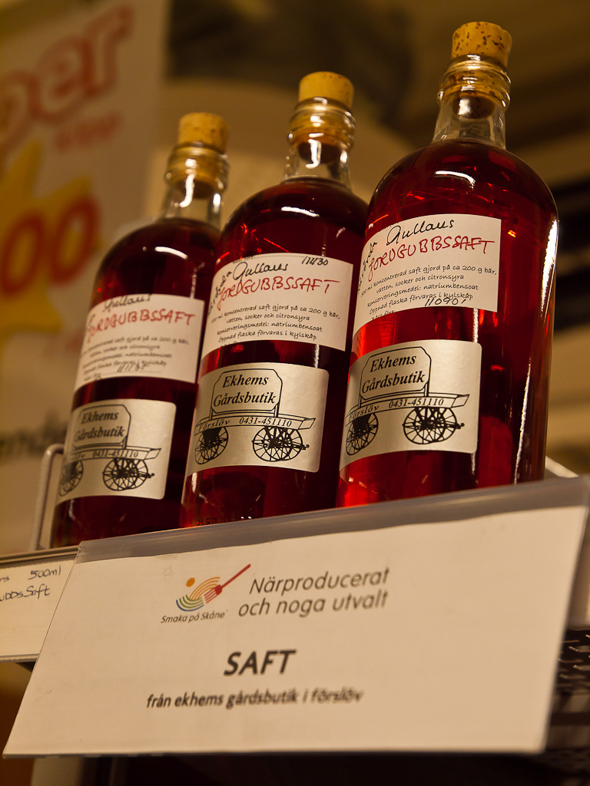
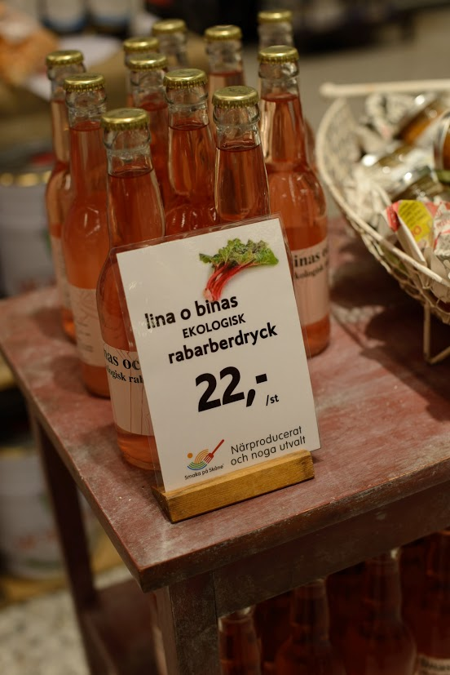
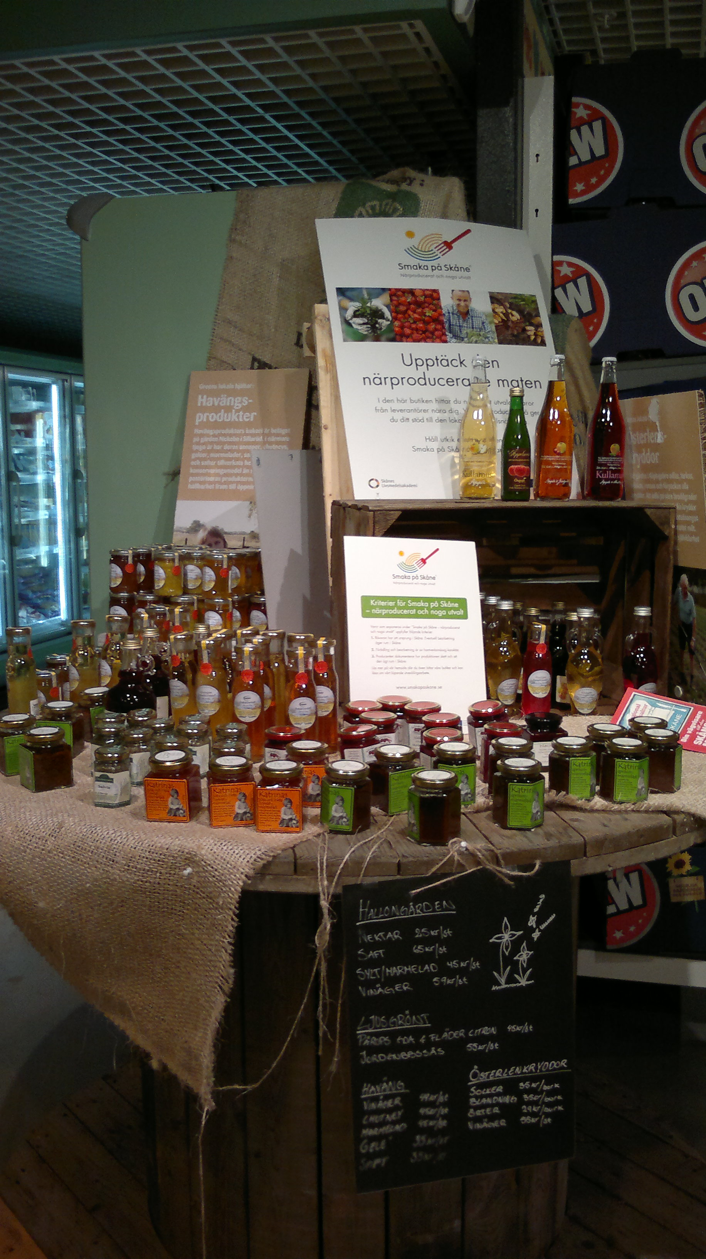
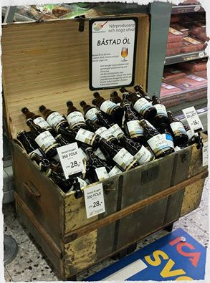
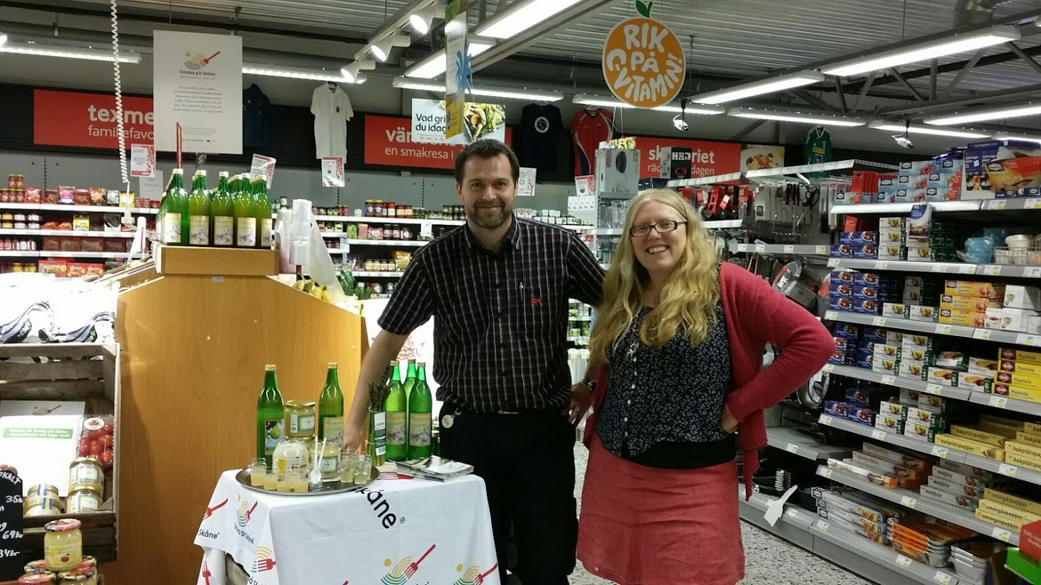

Slide 22
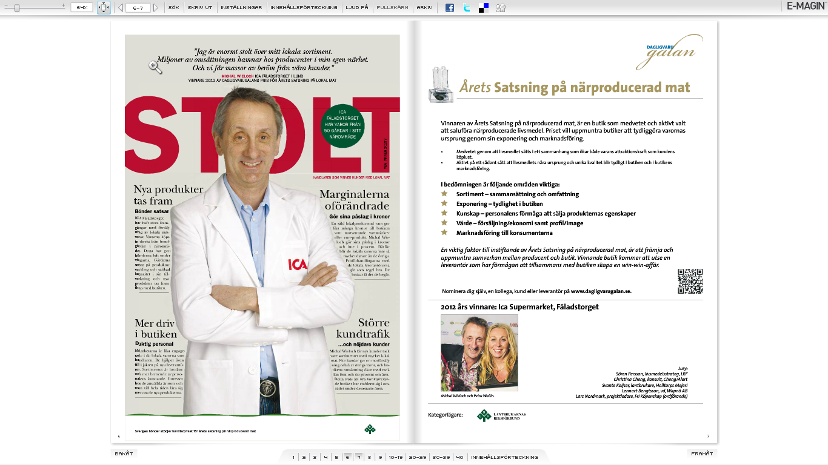
The essence of an innovation arena
”Proud people – strong cooperation”

Slide 23
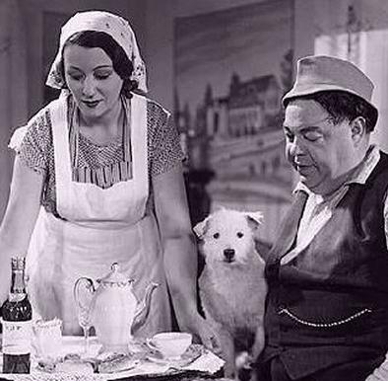
The heritage. Skåne is food!
When does a person from Skåne sweat?
(…when he eats…the saying goes)

Slide 24
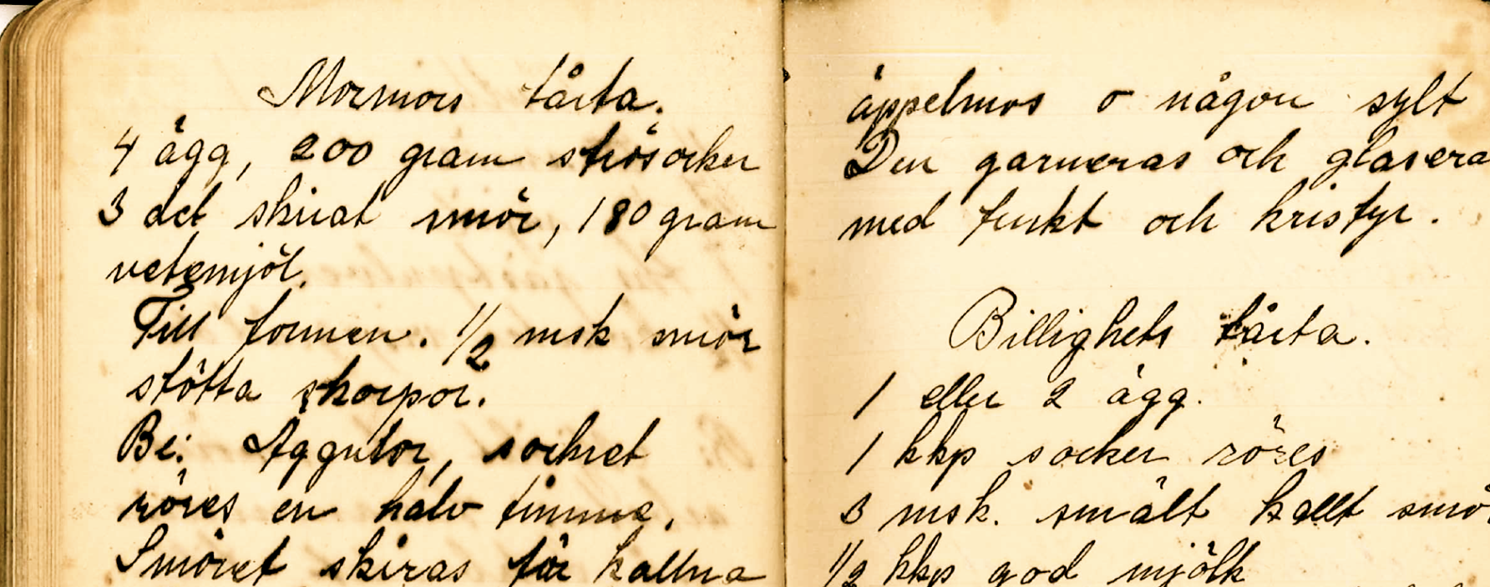
3. Innovation on tradition:
The New Skåne Kitchen.
New Skåne Kitchen ambassadors
Recept brochure, recipes on the homepage
A manifesto ”Skånsk Manifest”
february 2014
Network of young chefs
Development of competences –
network, restaurants, chefs, producers
How does the ethnic diversity influence the food culture nowadays; and how to utilize this in further develoopment?
Focus through course aktiviteter and events

Slide 25
4. Our manifesto:
IRL. The Skåne Food Festival.

Slide 27
Not just another market, but a unique food festival with focus on
Interactivity
Diversity
Innovation
Knowledge

Slide 28
What have we accomplished
”Taste of Skåne 2010-2015”
Building the platform, development of concepts
More than 50 competence activities
  Courses, seminars, speed dating, workshops, study trips, competitions etc.
More than 200 events in total, with food in focus or food as a cultural add-on
  Eurovision Song Contest 2013 (Malmö), first ESC to focus on local food and drinks
  And a lot of other smaller events locally and internationally
  Always in cooperation with other partners
  Focusing on creating ”the meeting place”, aka the arena, developing skills (concrete) and creativity around hospitality (soft values)
In total more than 6 700 participating stakeholders
Spreading our models and mindset!

Slide 29
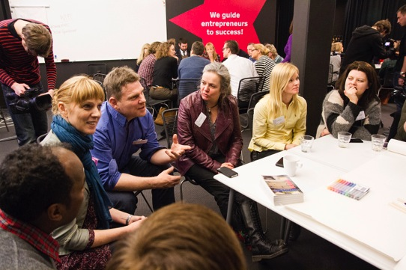
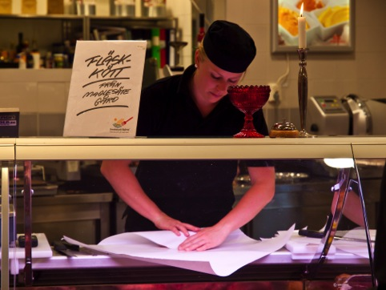
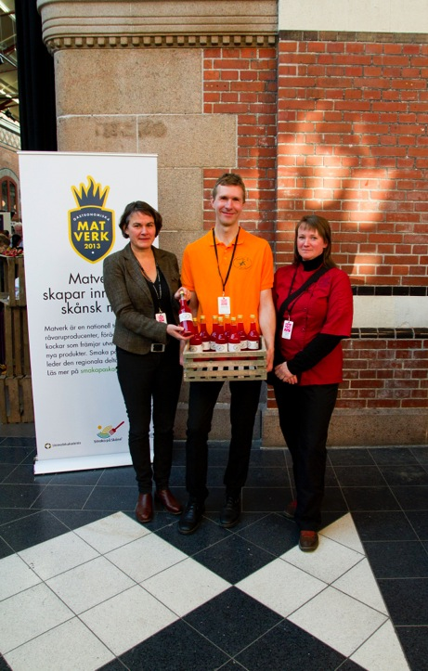
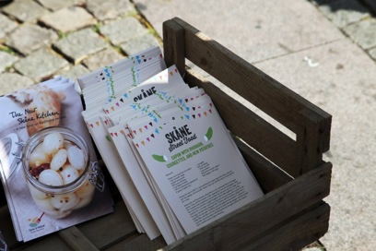
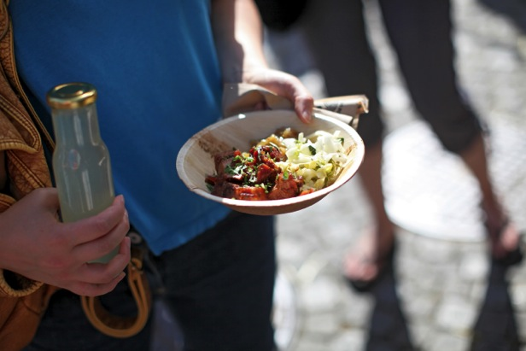
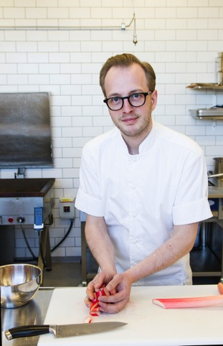

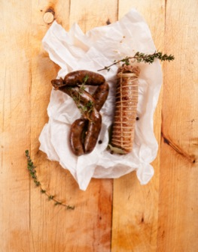
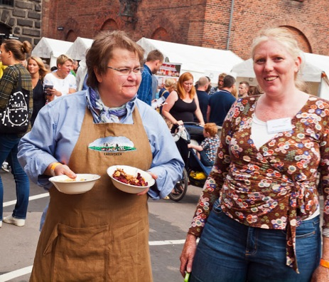
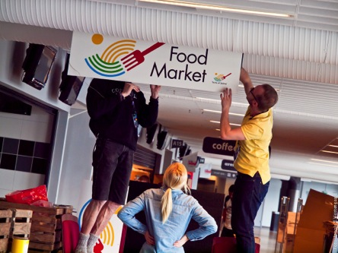
Notes:
Våra fokusområden just nu är butikskonceptet ”Smaka på Skåne – Närproducerat & Noga Utvalt”, kulinarisk turism, Nya Skånska Köket, skånska drycker, export, lokal mat i offentlig sektor, konceptualisering av arena- och eventmat och skånsk street food. Från och med 2014 arrangerar vi också Skånes Matfestival.

Slide 30
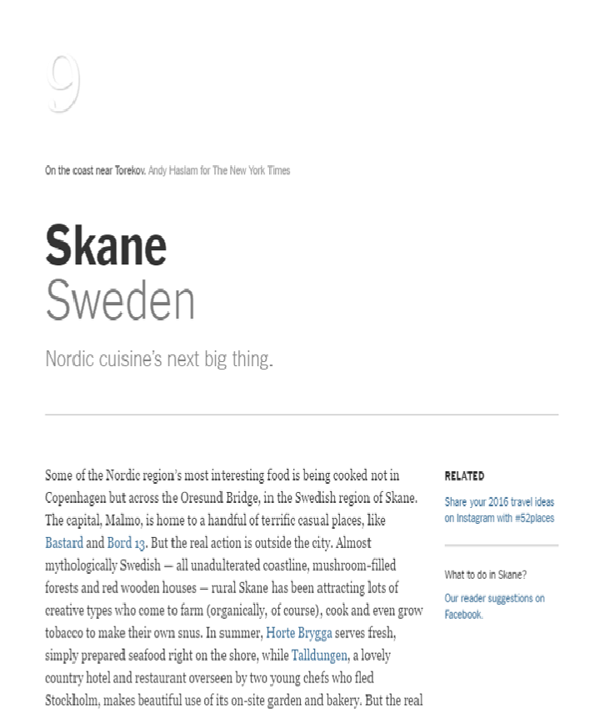
Skåne a culinary region
– we still have much to learn and do
9th place on NYT Travel list of destinations to travel to in 2016
  ”The Skåne kitchen is the next big thing”. We are proud!
It is NOT a coincidence! It’s all about:
Cooperation, cooperation, cooperation
– and so many possibilities still to dig into!
New innovative concepts and ways of collaborating
Public investments & strategic processes
Small scale companies growing in numbers and size
  Becoming even more professional as businesses
  Finding their way to the market
Innovation, hospitality
Supporting sustainable local economies, creating a thriving and growing rural Skåne!

