Slide 1
Research and Innovation Strategies for Smart Specialisation (RIS3)
John Edwards
European Commission
Smart Specialisation Platform
Casa Mateus, 19th May 2012

Slide 2
What is Smart Specialisation?
Evidence-based
All assets are considered
No top-down decision, but entrepreneurial discovery process involving key stakeholders
Global perspective on potential competitive advantage and potential for cooperation
Sourcing knowledge rather than re-inventing the wheel
Priority setting in times of scarce resources
Excel / Improve in something specific
Focus investments on regional comparative advantage
Accumulation of critical mass
Not necessarily focus on a single sector
“Build on the past whilst breaking with it”
Notes:
Regions cannot do everything in STI so they need to focus on certain domain
They need to focus by developing distinctive and original areas of specialisation (not by imitating each other
Where is (who has) the entrepreneurial knowledge?
Firms (best case)
Universities in the region
National research institute with regional agencies
Clusters’ managers
The smart specialisation principles are framed under the consecution of achieving a smart growth based in obtaining the most efficient innovation results with the most effective way of spending public resources.
Top down bottom up dichotomy is too simple

Slide 3
Where did Smart Specialisation come from?
Knowledge for Growth Expert Growth: D. Foray, B. van Ark
Transatlanctic productivity gap
KETs and the “Valley of Death”
“Most advanced regions invest in the invention of general purpose technologies,others invest in the co-invention of applications of the generic technology in one or several important domains of the regional economy” (Foray 2010)
Place based dimension: P. McCann, R. Ortega-Argilés
Embededness, related variety and connectivity
Political support from the European Union:
EU budget review
Europe 2020
Reform of Cohesion Policy and the RIS3 conditionality
Notes:
Transatlantic productivity and growth gap since 1995
Various reasons for the gap–labour markets, human capital, market segmentation, managerial practices, etc…
The R&D gap-and in particular in ICT and high technology sectors -is the best proxy for the gap –both in terms of levels and rates of return –with a lagged effect since 2000.
Cohesion Policy innovation support over total aid:
4% in 89’-93’
7% in 94’-99’
11% in 00’-06’
25% in 07’-13’
Reform of CP: Thematic prioritasation and results based

Slide 4
Is there a link between innovation and regional growth? “The general consensus…is that the driving force behind long-term economic growth is science, technology and innovation in its different forms and facets” (OECD 2011: Regions and Innovation Policy)
Source: Mikel Navarro et al, Basque Competitiveness Institute 2010.
"Until the 1980s, technology and innovation were under recognised influences in the explanation of differences in the rates of economic growth between regions in advanced industrial nations..." (Townroe)
Notes:
4
Este gráfico permite apreciar la posición que, con respecto a los indicadores compuestos de output económico e innovador presentan las diferentes CCAA españolas, en el conjunto de NUTS2 de la UE-27. En general, las CCAA españolas están mejor posicionadas en output económico (por ejemplo, en output económico el PV es la 71 de 262 NUTS2, mientras que en output innovador es la 146). Para corregir el hecho de que eso se pueda deber a la especialización sectorial y tecnológica del PV, he identificado dentro de las NUTS2 europeas aquellas cuya estructura sectorial y de patentes se encuentra más próxima de la del PV, y tales regiones las destaco con un rombo amarillo; pues bien, veo que el PV se sitúa muy bien en términos de output económico frente a tales regiones, mientras que en output innovador es superado por bastantes de ellas. En el PV (como en la mayoría de las CCAA españolas) parecería existir una cierta paradoja de la innovación: un desempeño económico que no se explica por su output innovador.
4

Slide 5
What is a RIS3?
Building on the past
Widespread experience of national/regional innovation strategies in the framework of the EU Cohesion Policy
Achieved greater co-operation among private and public stakeholders and better communication between technology providers and clients
Breaking with the past
Lack of international and trans-regional perspective
Not in tune with the industrial and economic fabric of regions
Too narrow vision of innovation
Picking the winner syndrome
The best performing regions were just copied
Notes:
“Inward looking” (parochial) without taking into account the global economy and ERA
Driven by external consultants: ownership by regional stakeholders?
Excessive focus on "technological" supply and R&D emphasis
A lack of understanding of the regional innovation system as an interaction of interdependent players, policies and institutions
"Study-oriented" approach vs. "applied-oriented" approach: credibility for businessmen?
National/Regional governments might feel threatened by:
a transparent and inclusive bottom-up process
analysis showing regional R&TD+i supply does not correspond to business demand;
new ideas, which cut across traditional power boundaries between Ministries;
project ideas which are not already in the "drawer" of a given Ministry

Slide 6
Case Study: West Midlands (UK)
Technological and skills diversification, innovation, supply-chain upgrading
Automotive industry (dominant sector in the region)
To increased local job retention; movement away from traditional automotive supplies; new product and service innovations; technological and skills upgrading.
Main pillars of the strategy:
Enhanced business support services: manufacturing advisory service, grant funding for strategically important companies, networked R&D centres of excellence
Skills-training services: graduate intership programme and retail support programme
A regional communication campaign: comprising data, intelligence gathering and provision service,

Slide 7
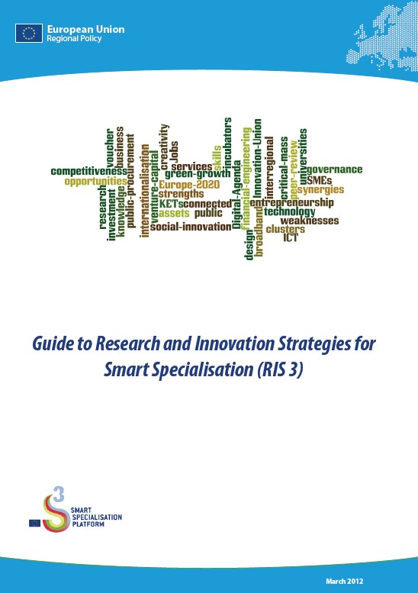
The RIS3 Guide
Edited by JRC IPTS in association with
DG REGIO and with contributions from:
D. Foray, P. McCann, J. Goddard, K. Morgan, C. Nauwelaers, R. Ortega
Commission officials from various DGs
S3 Platform research team
Available on the S3 Platform webpage!
http://s3platform.jrc.ec.europa.eu

Slide 8
Key steps for developing a RIS3
Step 1 – Analysis of regional context/potential
Step 2 – Governance
Step 3 – Vision for the future
Step 4 – Selection of priorities
Step 5 – Policy mix
Step 6 – Monitoring and evaluation

Slide 9
Key to success: Governance and framework conditions
Capacities and capabilities can influence strategy formation and
implementation
Priority setting and avoidance of capture by interest groups
Institutional arrangements to facilitate process of entrepreneurial
discovery (soft and hard institutions; some easier to change than
others)
Problem of cross crutting competences for innovation policy
Relationship between national and regional innovation systems

Slide 10
The S3 Platform – here to help you innovate too!
http://s3platform.jrc.ec.europa.eu
JRC-IPTS-S3PLATFORM@ec.europa.eu
Notes:
10

