Slide 1

Regional Clusters
Ana Teresa Tavares Lehmann
University of Porto – FEP, CEF.UP, EGP-UPBS

Slide 2
Clusters: Working Definition
“Geographic concentrations of interconnected companies, specialized suppliers, service providers, firms in related industries, and associated institutions (e.g., universities, standards agencies, trade associations) in a particular field that compete but also cooperate”
(Michael Porter, 2000)

Slide 3
Clusters – not a new concept
Marshall 1890, 1920
Industrial districts; Spatial dimension
Agglomeration economies; Externalities
“something in the air”
“When an industry has thus chosen a locality for itself, it is likely to stay there long: so great are the advantages which people following the same skilled trade get from near neighbourhood to one another. The mysteries of the trade become no mysteries; but are as it were in the air...” (A. Marshall, Principles of Economics, 1890)

Slide 4
Clusters – not a new concept
3 key aspects:
  Knowledge spillovers
  Input-output relationships
  Labour market pooling
Collective efficiency and increasing returns
Benefits of a shared vision, co-location and co-evolution
Specialisation – increasing Productivity - Competitiveness
Clusters as a convenient and pragmatic organising principle through which to focus resources and build partnerships
Building strong regional economies takes decades

Slide 5
Regional Clustering
From Fordism to post-Fordism:
  From hierarchical firms to networks
Alliance capitalism (Dunning, 1997)
The Associational Economy (Cooke and Morgan, 1998)
Porter: Clustering for Competitiveness
  Productivity; greater ability to innovate; lower barriers to entry; public policy has a significant role to play (cluster upgrading, helping infant clusters)
Industrial districts: agglomeration economies
  Marshall, Becattini, Krugman
  Cumulative causation leading to path dependencies
Learning regions, innovative milieux and innovation systems
  Clustering: a tool to improve a region’s knowledge base and innovativeness
  Learning: key factor of regional competitiveness (Maillat, Morgan, Florida etc)

Slide 6
Relevant Dimensions of a Cluster
Geographic scope: on which geographic scale does the cluster operate?
Vertical scope (depth – deep/shallow): what supplier-customer chains can be identified in a cluster?
Horizontal scope (breadth – broad/narrow): are there competitors cooperating in the cluster?
Also:
  Activity base (activity-rich or activity-poor)
  Growth potential (embryonic & growing to mature & declining)
  Innovative capacity (high or low)
  Competitive position (in national and international markets)
  Governance structure (how transactions are managed)
  Ownership structure (domestic vs foreign, mixed)
  Cluster ‘type’ (working, latent, potential, policy-driven, ‘wishful thinking’)
  Specialized organizations
  Government policy towards clustering

Slide 7
Clusters and the promotion of Competitiveness
Transmission mechanisms
Competitiveness
Cost reduction
R&D + innovation
Projects in Partnership
Knowledge & information sharing

Slide 8
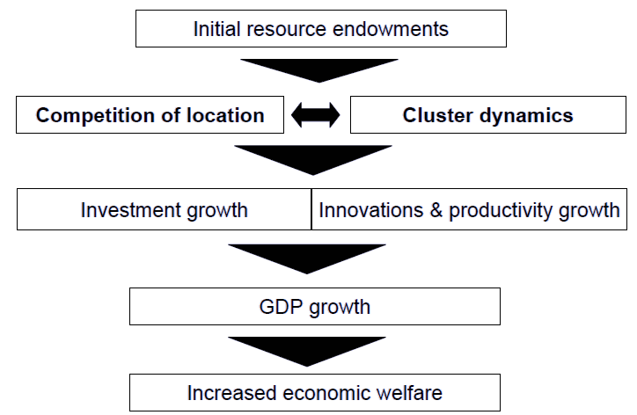
The economic growth spiral

Slide 9
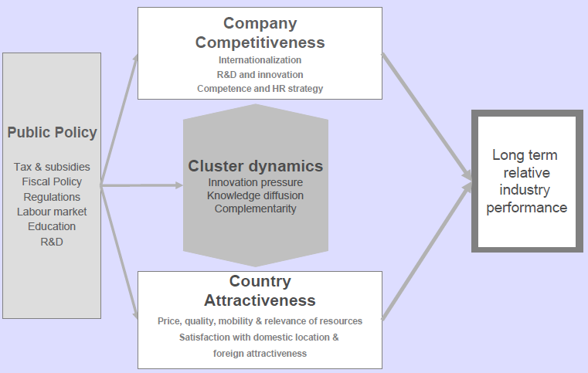
The long term development and performance of industries

Slide 10
Areas of Impact
Employment
International trade – exports
Internationalization through contractual forms and FDI
Entrepreneurship
R&D, tech development, patents
Strong cluster environment
  reduces barriers to entry and growth
  Enhances regional comparative advantage

Slide 11
Clusters & Smart Specialization
Smart specialization strategies are place-based strategies
Clusters are an important element in smart specialization strategies (Commission Communication: Regional Policy contributing to smart growth, 2010)
Value for money, i.e. smart R&D investment in the context of scarce public resources; prioritizing very clearly
Outward orientation
Users and customers: a new source of inspiration, involved directly in co-creating value
An essence of smart specialization is to explore new cross-sectoral linkages that become growth drivers

Slide 12
Internationalization of Clusters
Internationalization of the members of the cluster
Internationalization of the cluster as a whole
Different types of internationalization
  Exports; Contractual Modes; Foreign Direct Investment (Subsidiaries)
Networks; Resource/knowledge-based view; transaction costs
The cluster as a facilitator, an enabler
  for initiatives that individual members cannot afford or develop alone
Collaborative networks: ‘punching above our weight’
  Can overcome liability of smallness (of firms/organizations & countries)

Slide 13
Internationalization of Clusters
Clusters help
  Overcoming scarcity of resources and competences: accessing them
  Particularly important in clusters dominated by SMEs; linkages
  Cost/risk reductions (internationalization is no piece of cake!) & increase in potential gains; scale & specialization leading to increases in profitability and other performance indicators
  Efficiency gains, knowledge accumulation, visibility, brand/image: $$$
  Value added & created: help integrated solutions, synergies
What can/should the cluster do?
What is the role of public policy?
  Enabler, simplifier, … or else?

Slide 14
Regional Cluster Policy
Clusters may (or may not) arise spontaneously
  Can regional clusters be engineered?
  Starting clusters ex nihilo is very difficult; cathedrals in the desert...
  Example of a mainly market-induced cluster: Watchmaking cluster in the Swiss Jura (Maillat, 1995); the role of tradition in production
Nowadays, an increasing number of OECD and emerging countries’ governments actively pursue cluster-based policy as a means to foster regional development
  All government efforts to develop & support clusters in a specific region
  From studies to setting up platforms, to establishing brokering and networking schemes to providing subsidies for cooperation

Slide 15
Regional Cluster Policy
Levels of policy – multiple, juxtaposed
  Policies at national and regional, even city, level
  Supranational programmes, e.g. Regional Innovation Strategies (RIS) programme of the European Commission, OECD’s Focus Group on Clusters, etc
An heterodox economic policy mix framework
  In which relevant dimensions of economic policy at large are reformulated in terms of regional policy (Storper & Scott, 1995)
  3 main policy areas: regional, S&T, industrial/enterprise policy
  Hence, cluster policy can hardly be isolated from other policy areas
  Difficult to assess how many resources have been committed to cluster policy – there’s no cluster policy per se?
Benchmarking efforts – identifying and matching ‘best practices’
  Learning by comparing
  Yet, successful examples cannot be transferred mechanically – ‘best practices’ more a source of inspiration than recipes for successful regional development

Slide 16
Regional Cluster Policy
Targets: places, sectors, value chains, specific actors
Identification of clusters:
  Top-down
  Bottom-up
  A combination of the two
Competitive or non-competitive

Slide 17
Regional Cluster Policy
Co-operative, multi-actor and place-based
  Harnessing proximity
Promoting interclusters’ linkages: cross-fertilization
  Cluster overlap
  Networking platforms
Opportunities for ‘high tech’ regional clusters can be found in - paraphrasing Schumpeter’s (1934) term for innovations – ‘new combinations’ of existing clusters
  New clusters are often spin-offs of existing ones
  Regional specializations transformed – structural change
  Instruments to maintain employment and promote restructuring and adaptation in other sectors
Cluster upgrading; cluster growth and cluster decline

Slide 18
Regional Cluster Policy: Risks
Related to the use of a cluster approach generally
More specific risks related to the design of such programmes
Picking winners
Insufficient economic diversification
Lock-in
Over-reliance on key firms
Just throwing money to selected actors
Lack of private sector involvement

Slide 19
Regional Cluster Policy
The problem of evaluation
  Lack of robust tools to measure whether or not such policies are successful
Some sort of monitoring component for ongoing funding decisions
...Policy inconsistency and short-termism...
Policy coherence within and across levels of government
Any policy (strategy) is as good as its implementation

Slide 20
Cluster Policy in Portugal

Slide 21
Cluster policy in Portugal: Brief background
1993-1994: Porter/The Monitor Company “Building Portugal’s Competitive Advantage” – not much since then…
Until 2008: Launch of “Collective Efficiency Strategy” initiative
Competition induced by Portuguese Government – recognition of clusters
  2 types: ‘competitiveness pôles’ and ‘other clusters’
  Partnership
  Leadership by the private sector
  Focus on innovation and on stimulating linkages between actors

Slide 22


TIMELINE
2008
MAY-JULY
JULY-OCT
SEPT-OCT
NOVEMBER
OCT-DEC
Private sector involvement process
Presentation of applications for 1st ‘call’
Evaluation of applications
Preparation of applications for
1st ‘call’ of the programme
Public launch of the programme

Slide 23
TIMELINE
2009
2010
2011
JANUARY
JAN-JULY
JULY
Implementation of
the proposed strategies by recognised clusters
Evaluation of the strategy and of the respective implementation process
Results of
1st ‘call’
Recognition
of 19 clusters
Reformulation
of applications

Slide 24
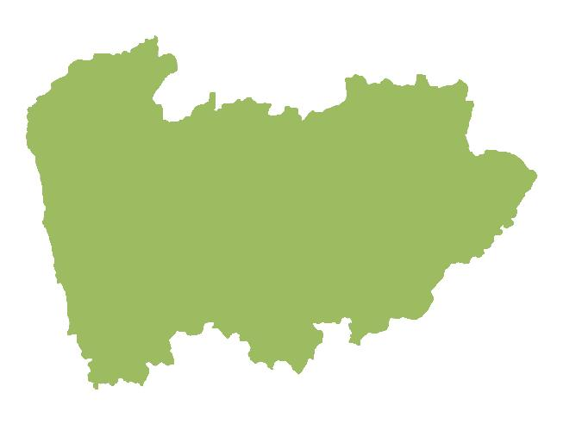
CLUSTERS – NORTE REGION
FASHION
HEALTH
AGRO- INDUSTRIES
PRODUCTION TECHNOLOGIES
TOURISM
FOREST-BASED PRODUCTS
ICT
CLUSTERS
AUTOMOTIVE AND MOBILITY
ENERGY
DOURO WINE
HABITAT
CREATIVE INDUSTRIES
FURNITURE
MARINE
Headquarters in the Norte Region
Headquarters outside the Norte Region

Slide 25
Some general comments
…in spite of certain limitations…
Forged effective partnerships between different actors
Created strong networks, in the majority of cases
  With the best and most representative players
Helped focusing on innovation & internationalisation
Increased dynamic
  Number of participants & tighter links between them
  Projects implemented – continuous successful bidding
International visibility & credibility

Slide 26
Thank you for your attention
(and for clustering here today)
Ana Teresa T. Lehmann

